Slide 1
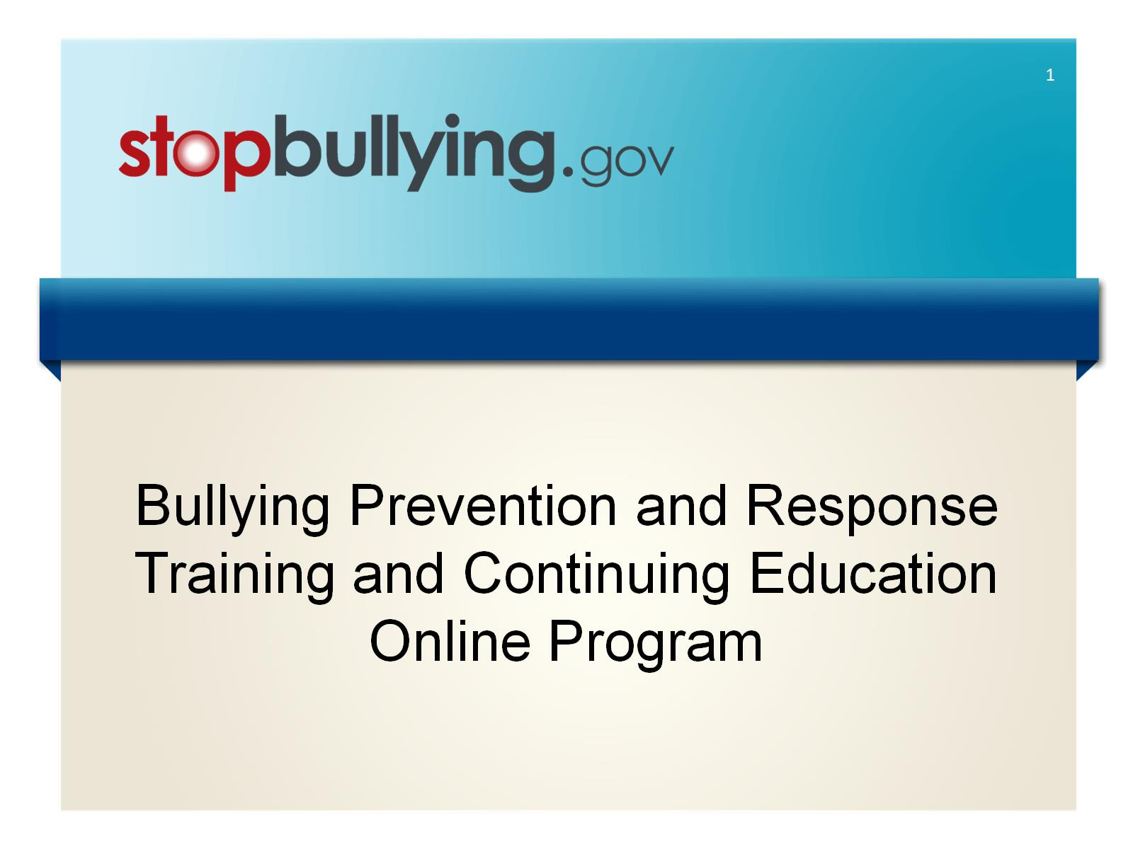
Bullying Prevention and Response
Training and Continuing Education Online Program

Slide 2
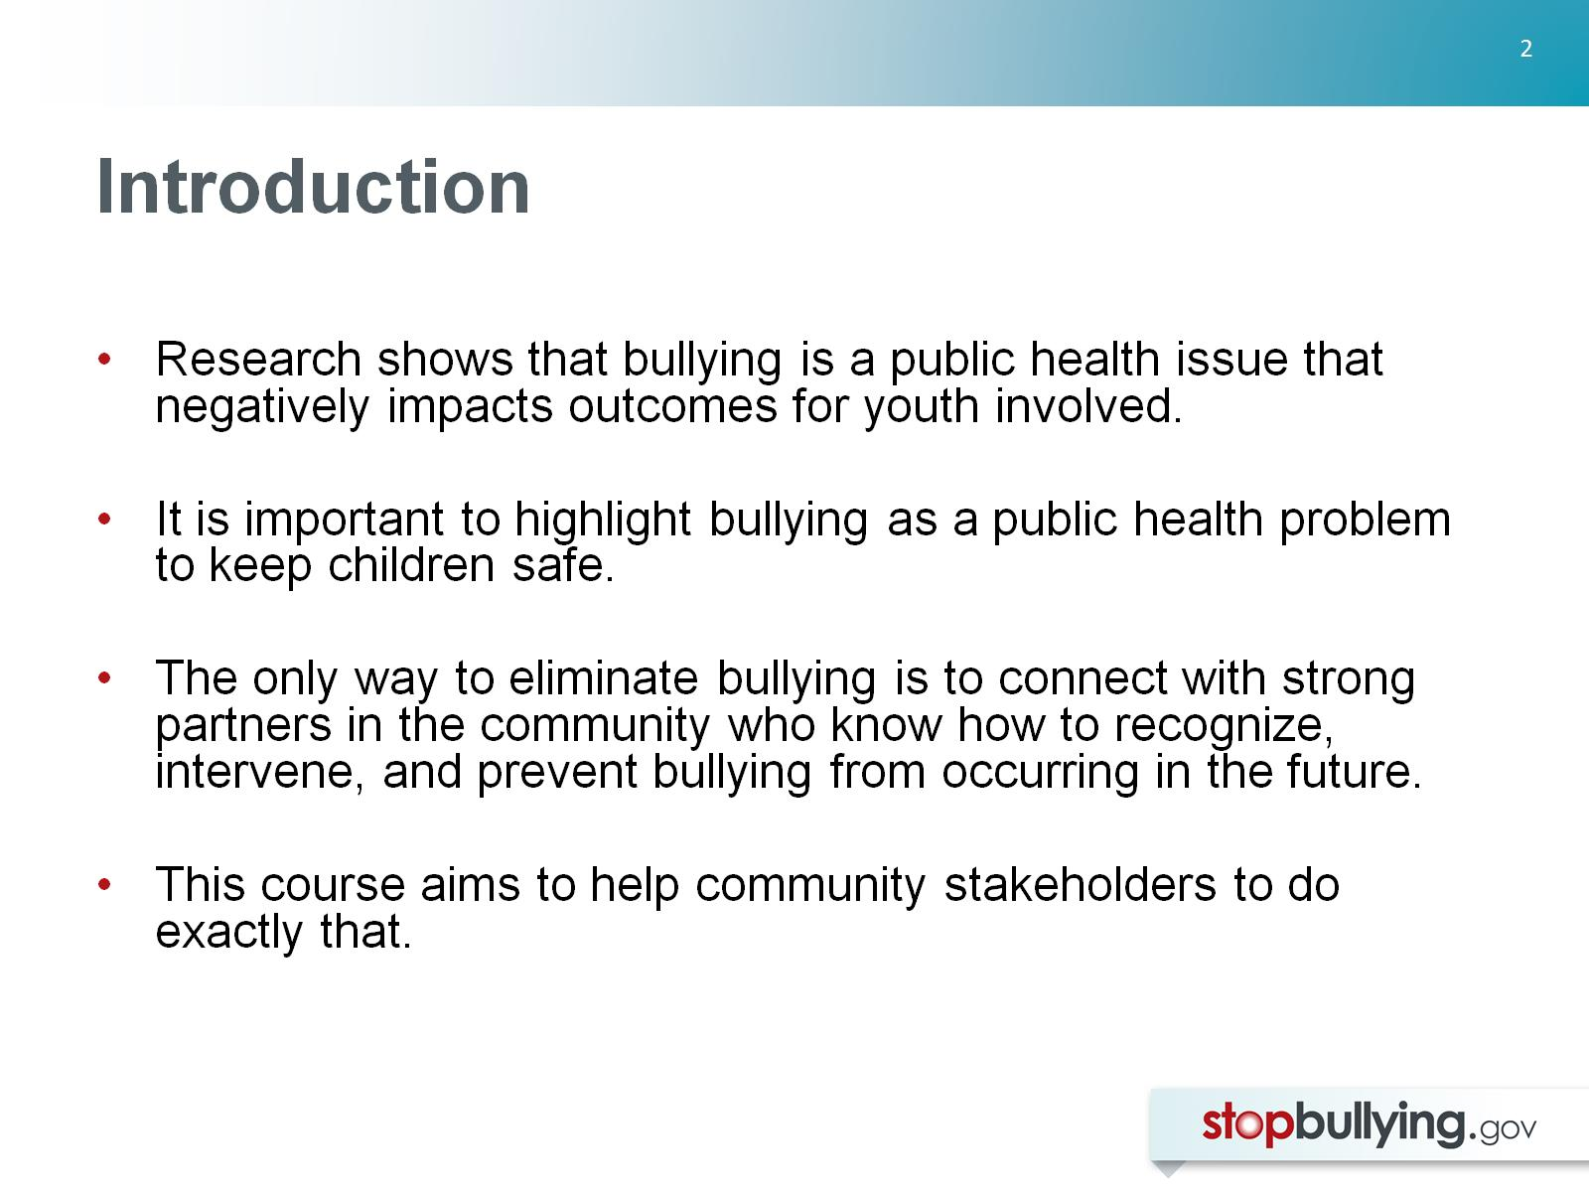
Introduction

Slide 3
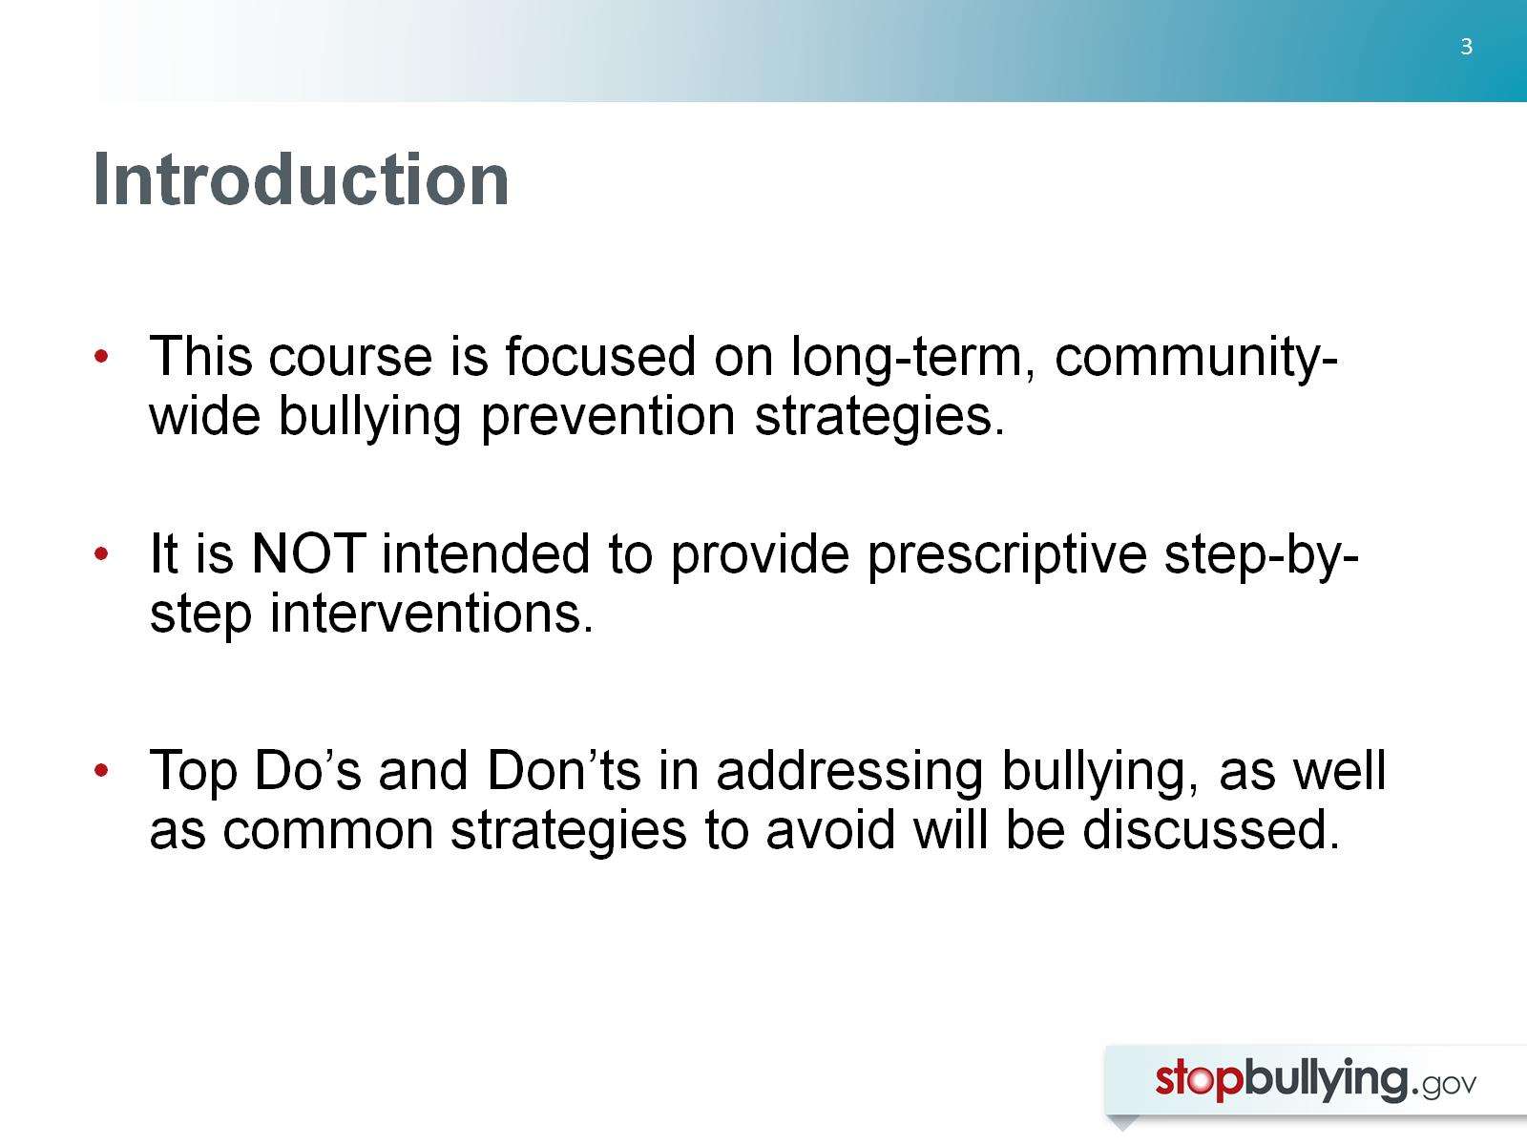
Introduction

Slide 4
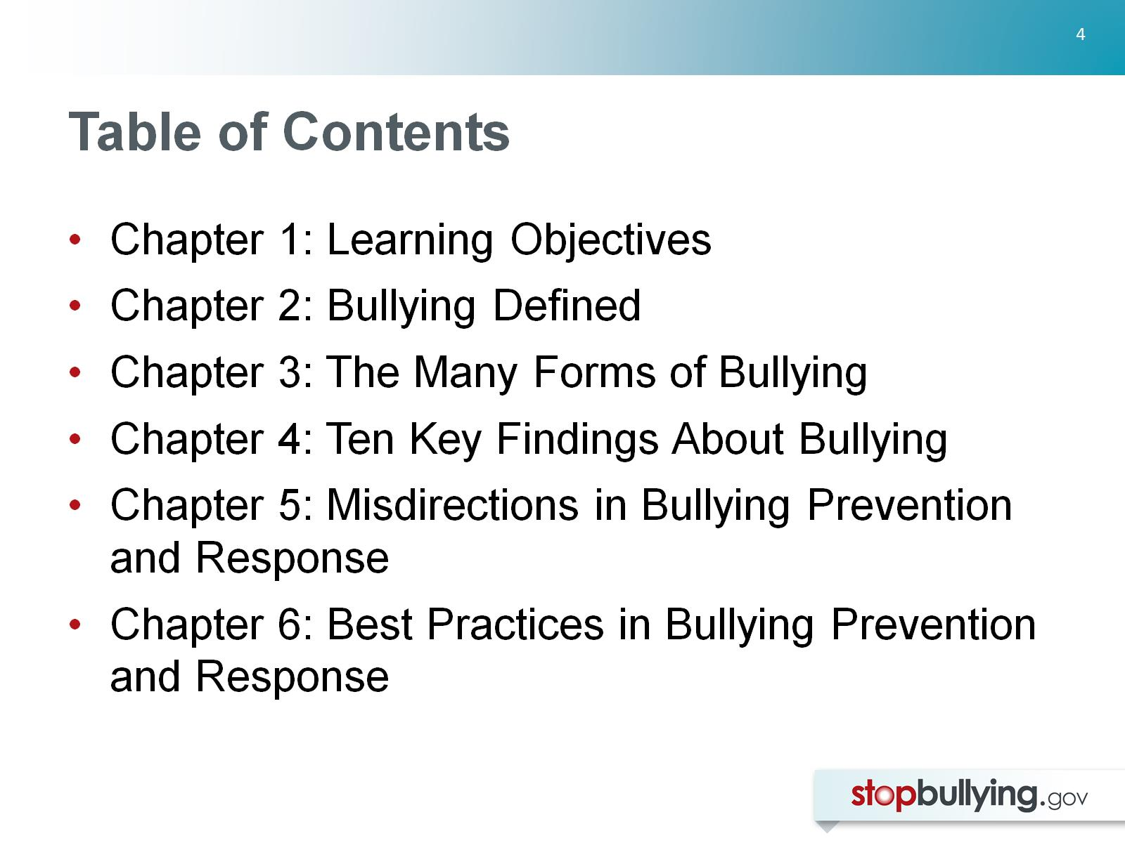
Table of Contents

Slide 5


Slide 6
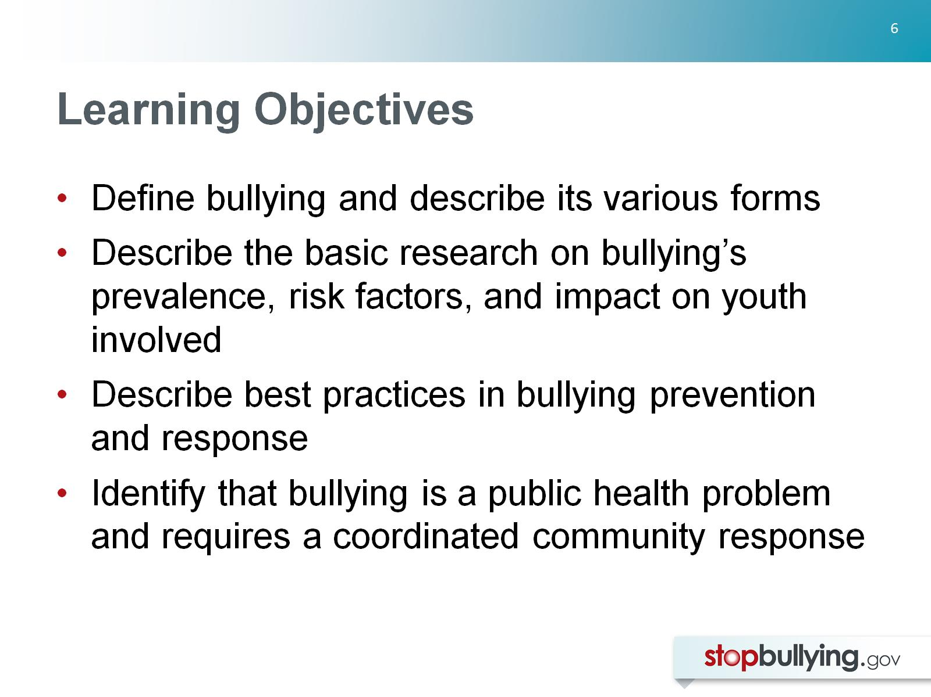
Learning Objectives

Slide 7
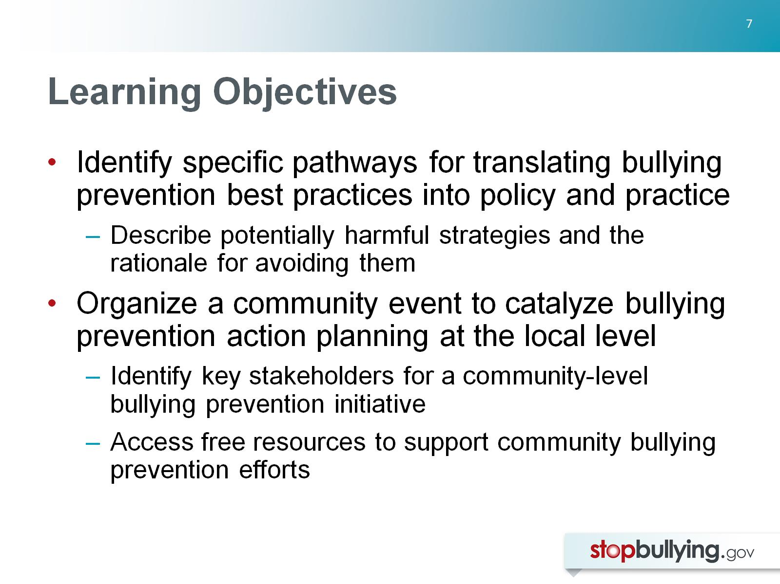
Learning Objectives

Slide 8
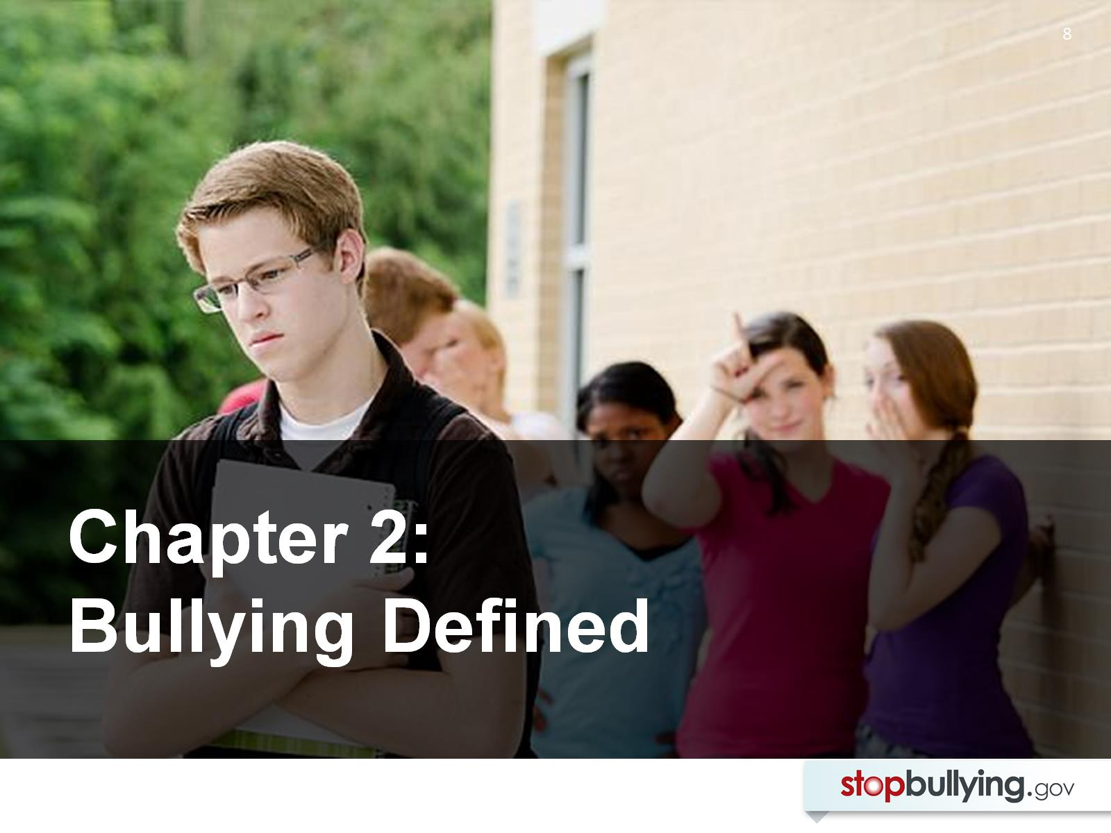

Slide 9
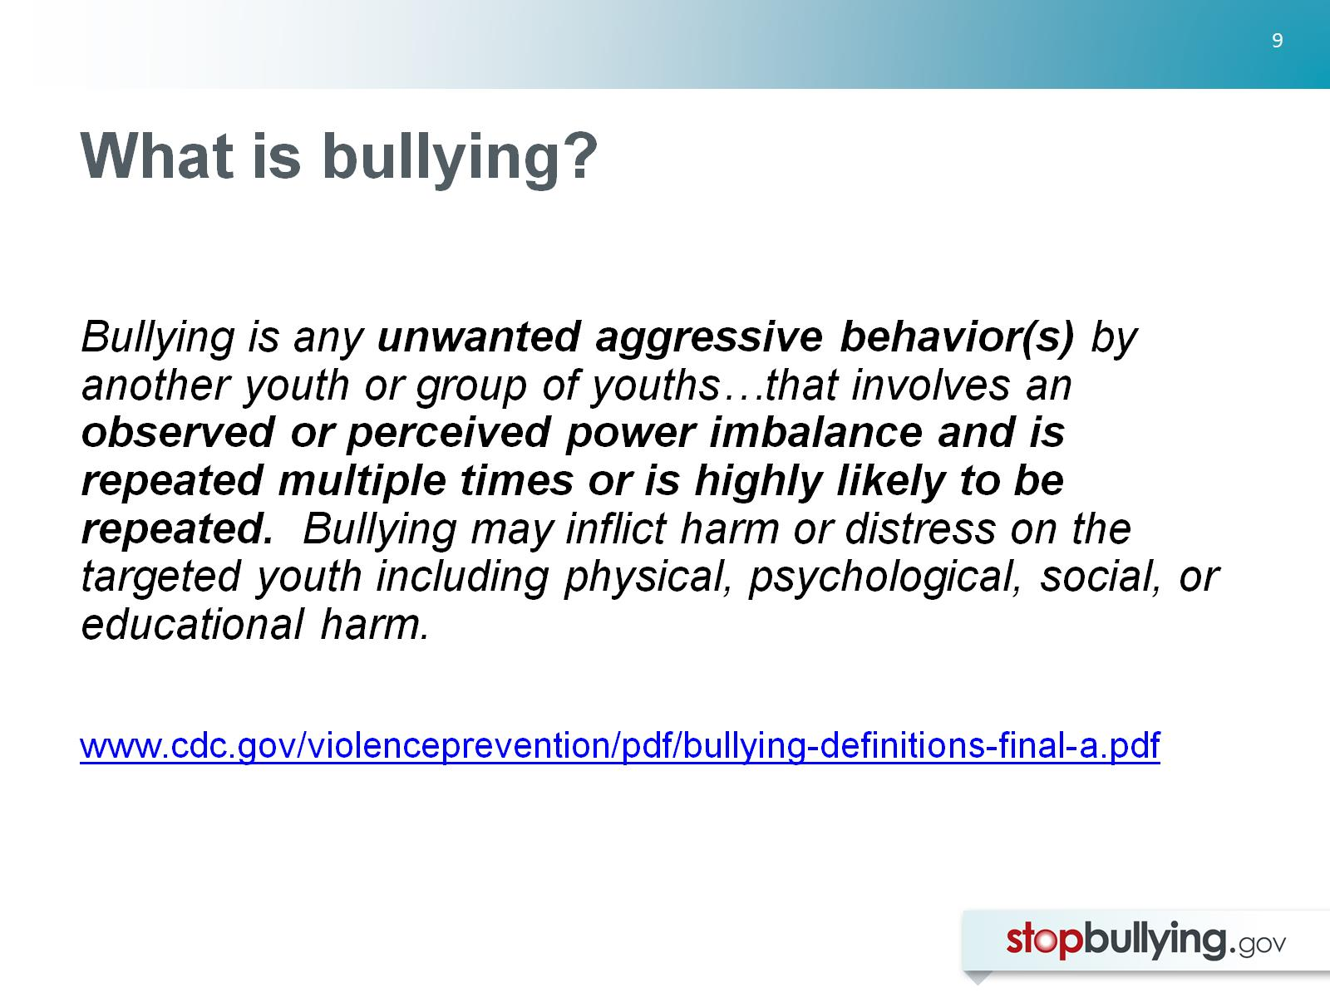
What is bullying?

Slide 10
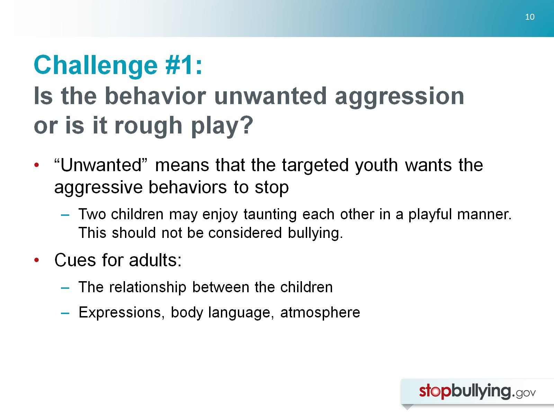
Challenge #1:
Is the behavior unwanted aggression or is it rough play?

Slide 11
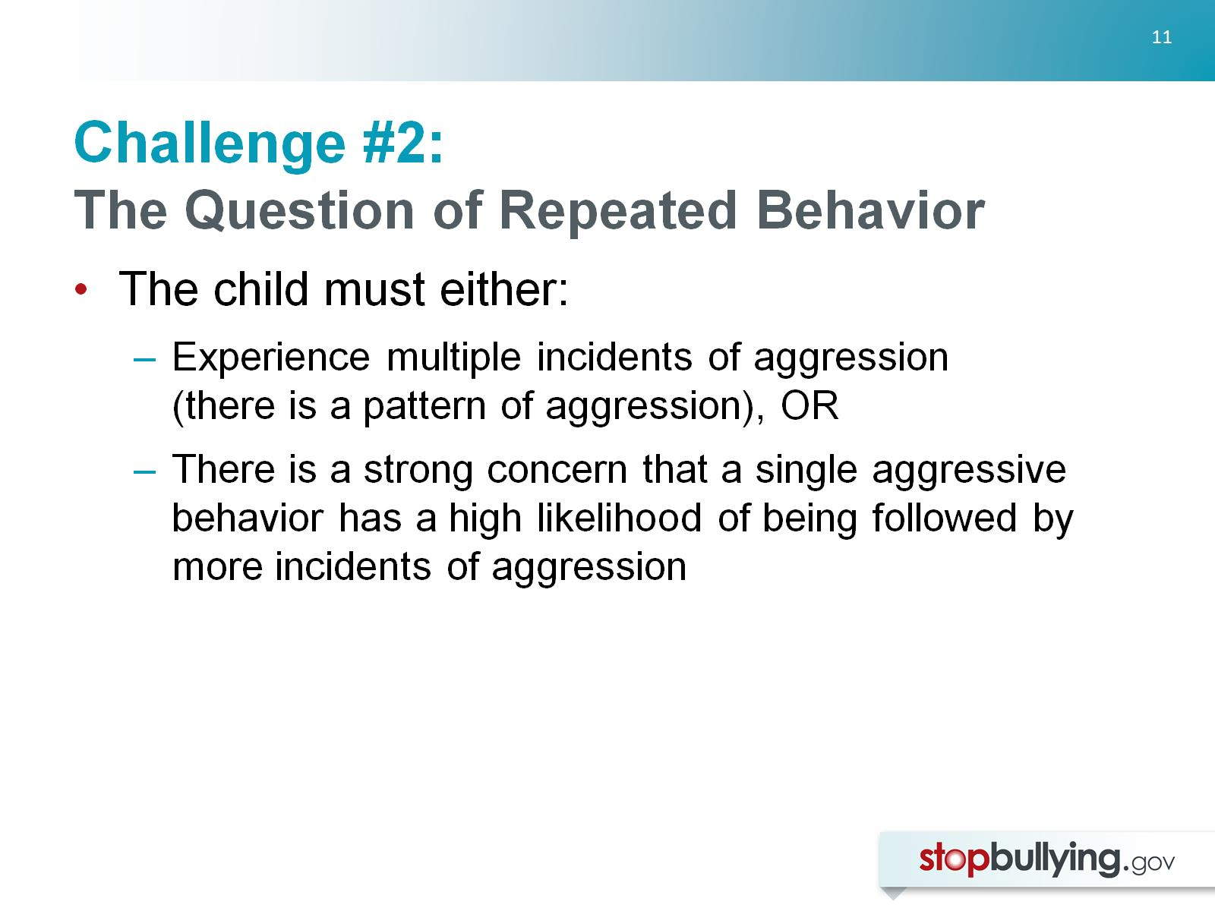
Challenge #2:
The Question of Repeated Behavior

Slide 12
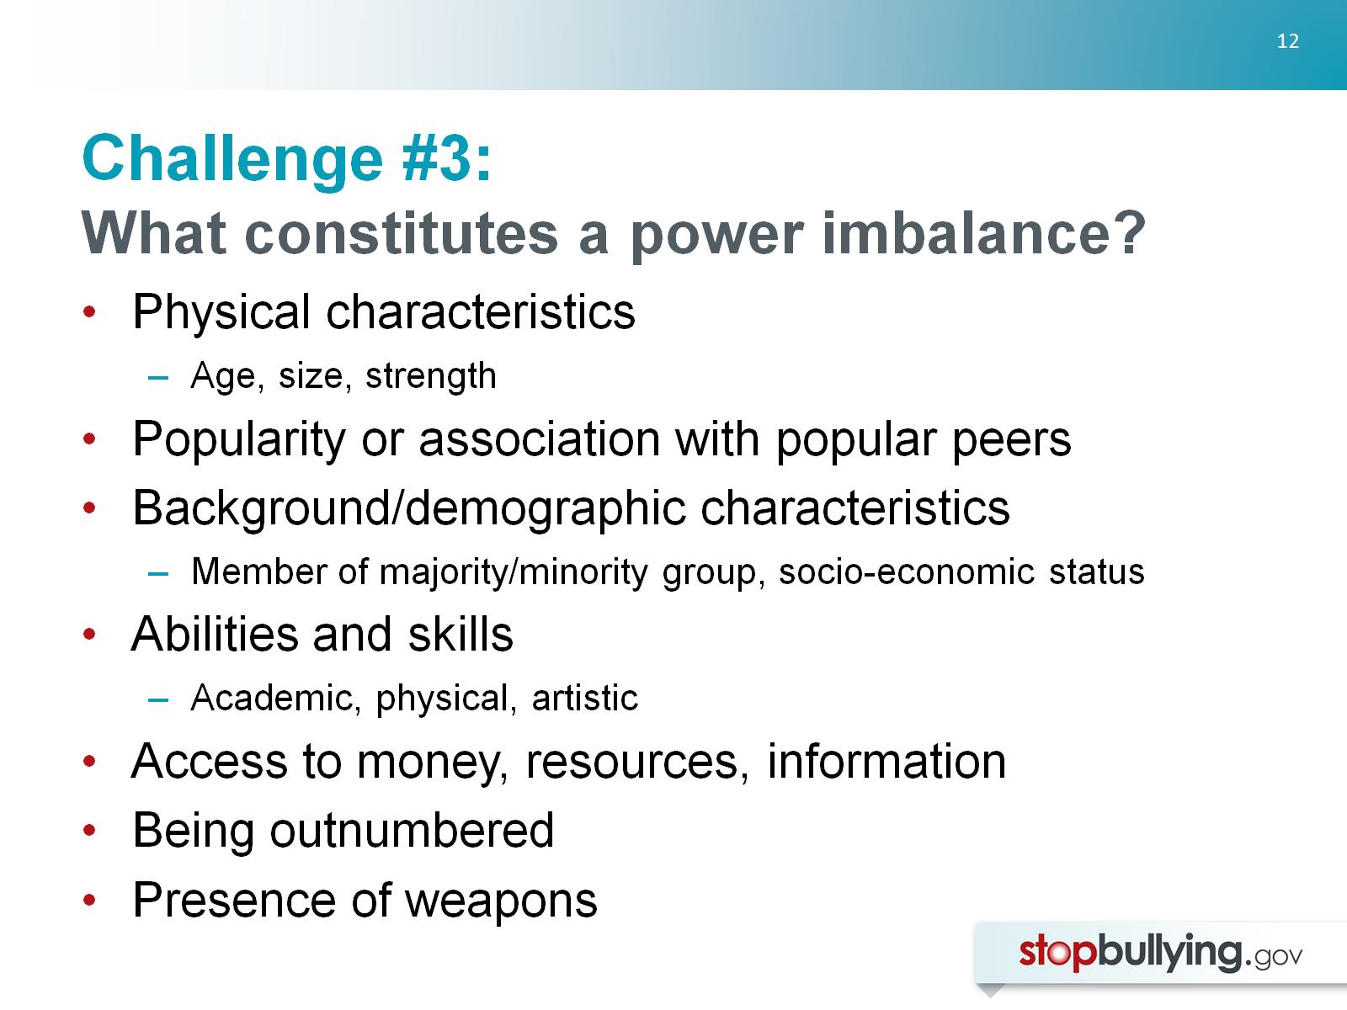
Challenge #3:
What constitutes a power imbalance?

Slide 13
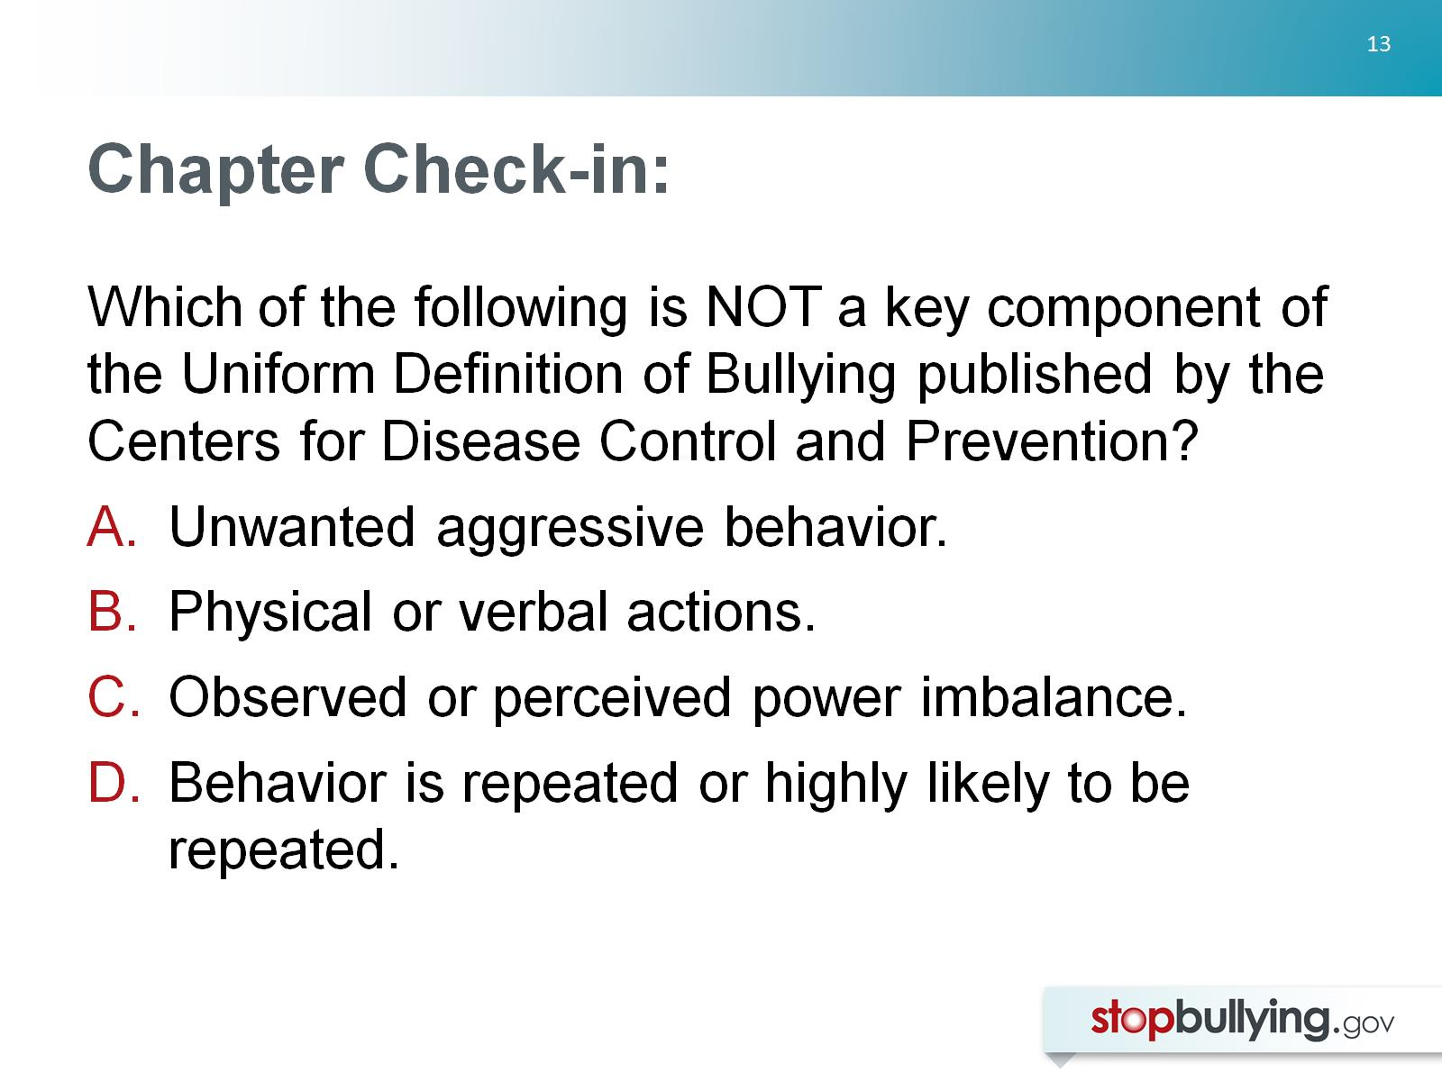
Chapter Check-in:

Slide 14
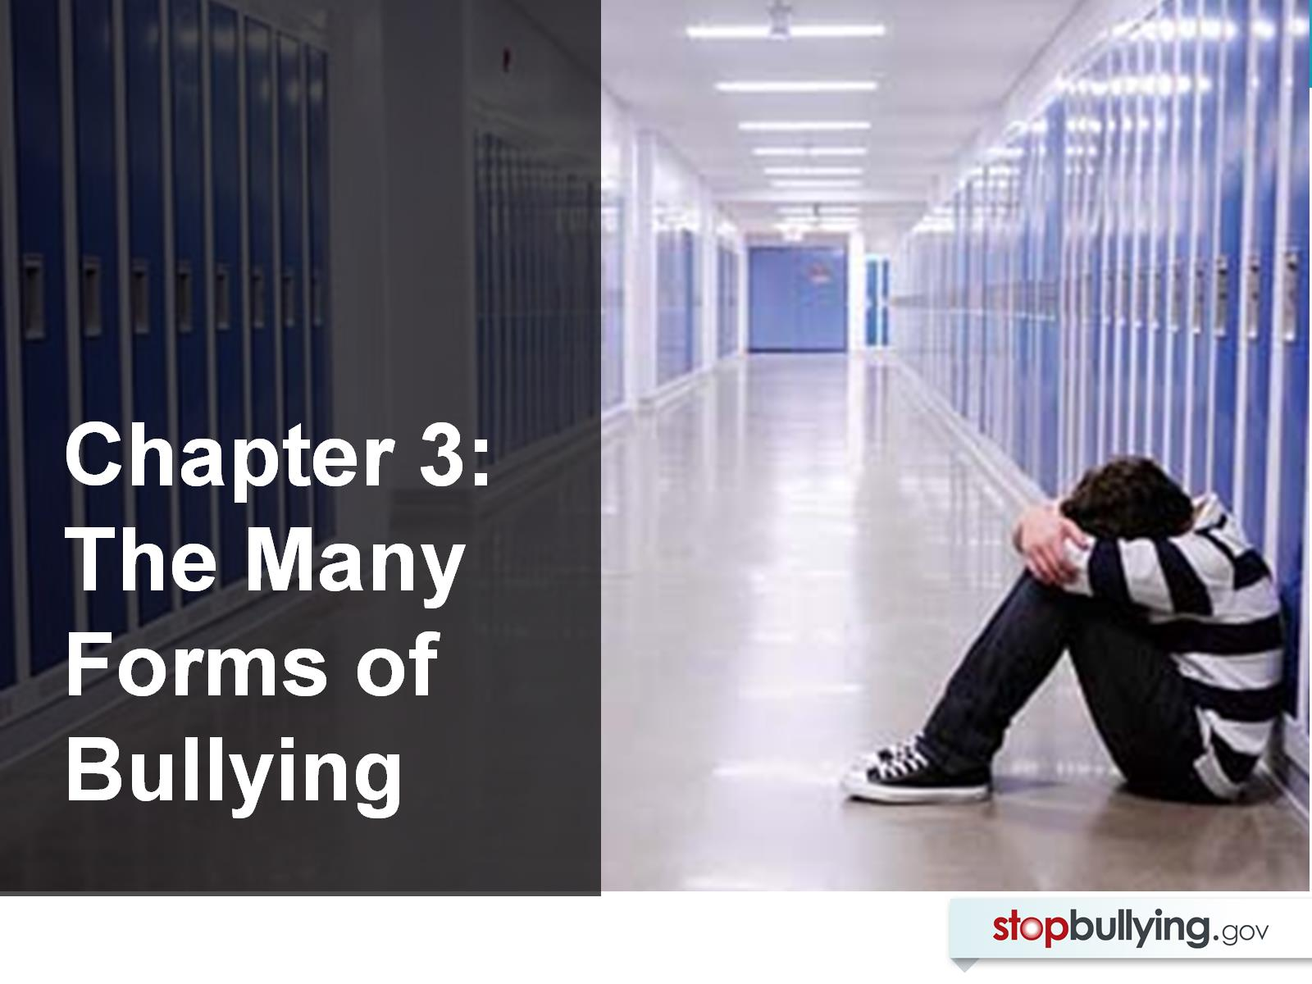

Slide 15
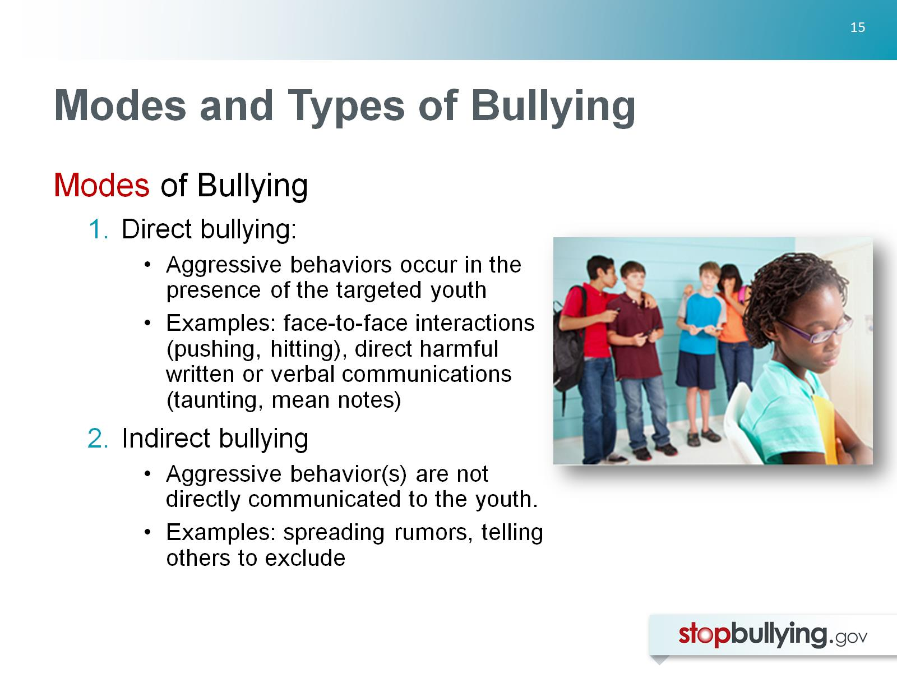
Modes and Types of Bullying

Slide 16
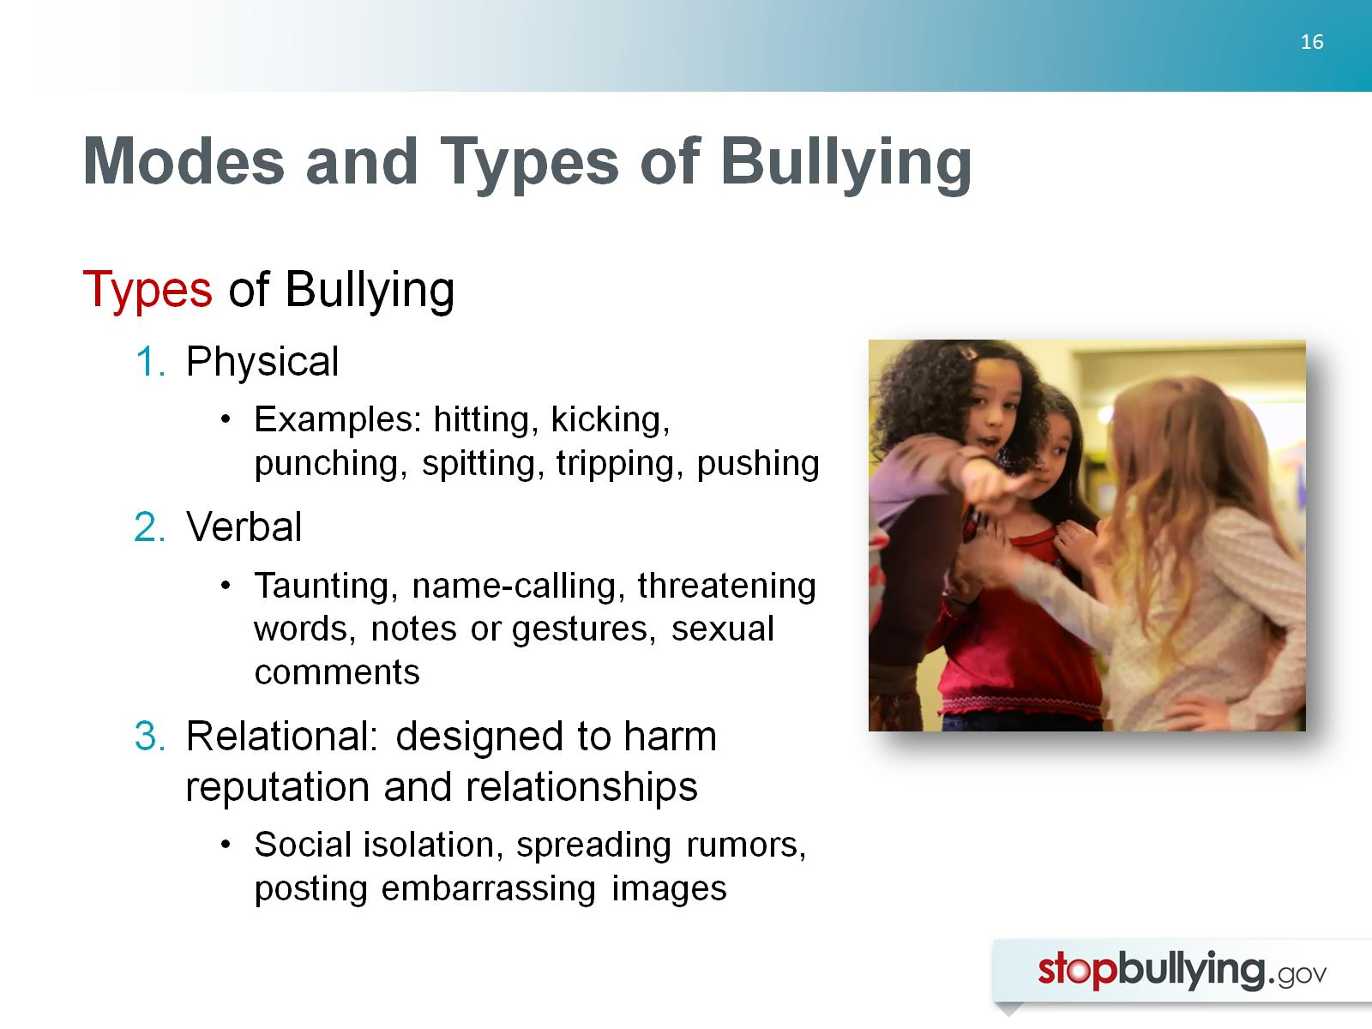
Modes and Types of Bullying

Slide 17
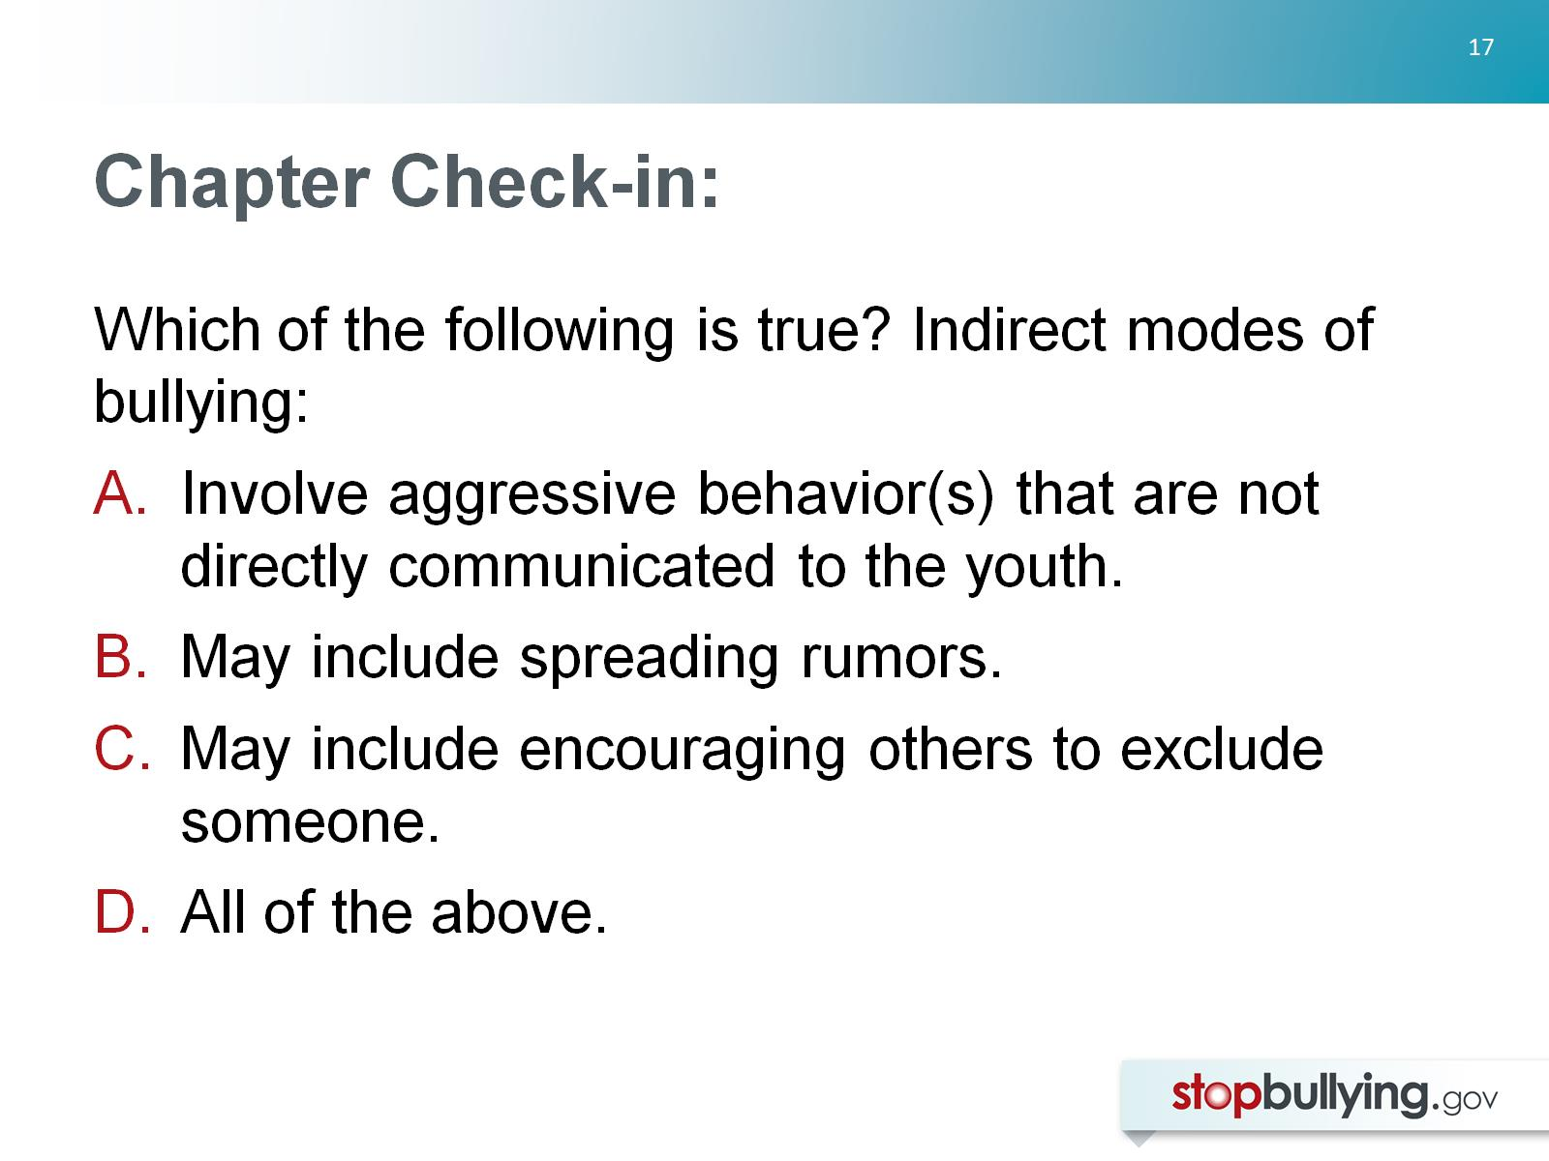
Chapter Check-in:

Slide 18
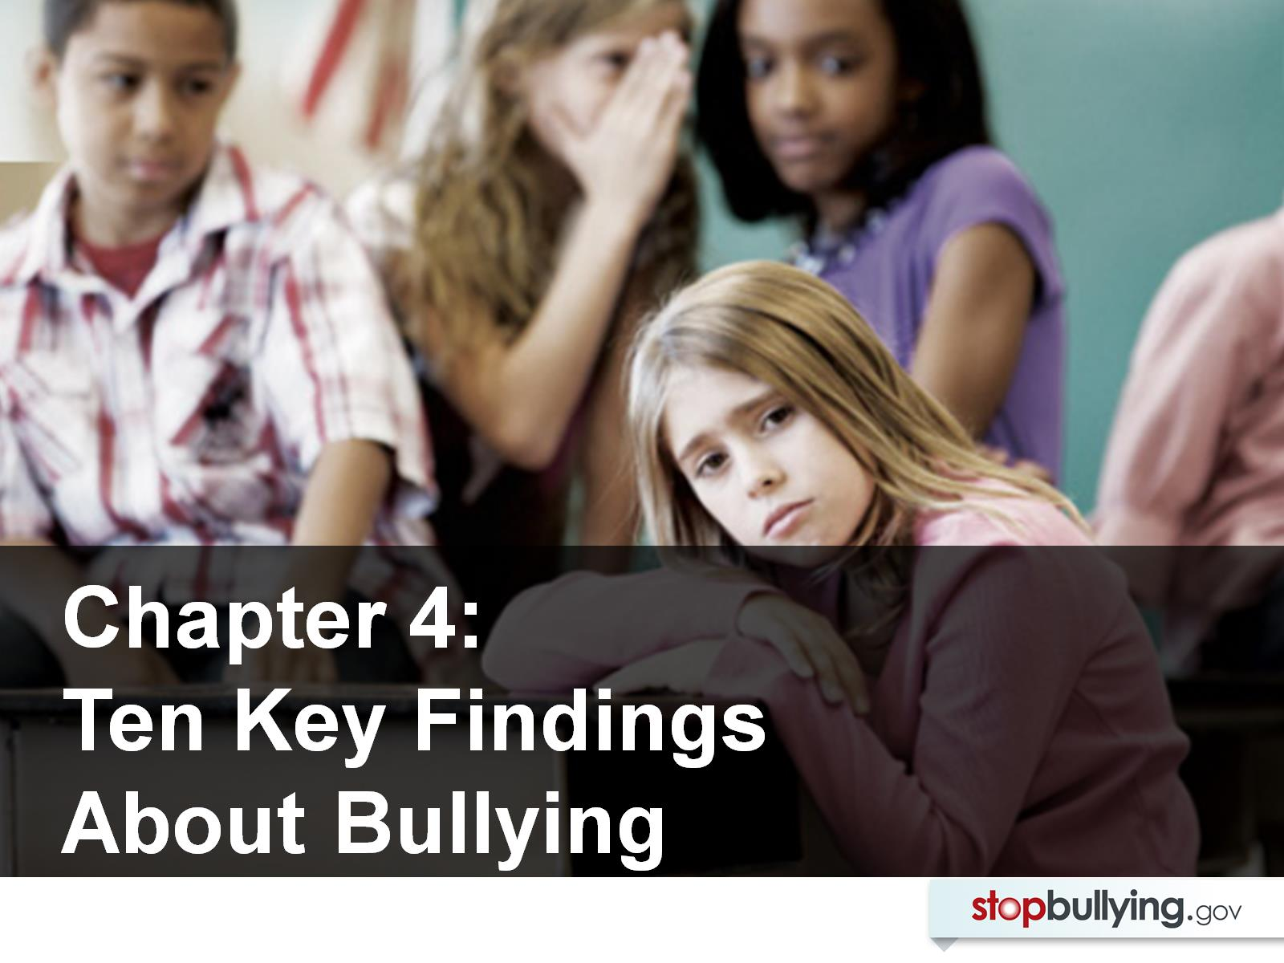

Slide 19
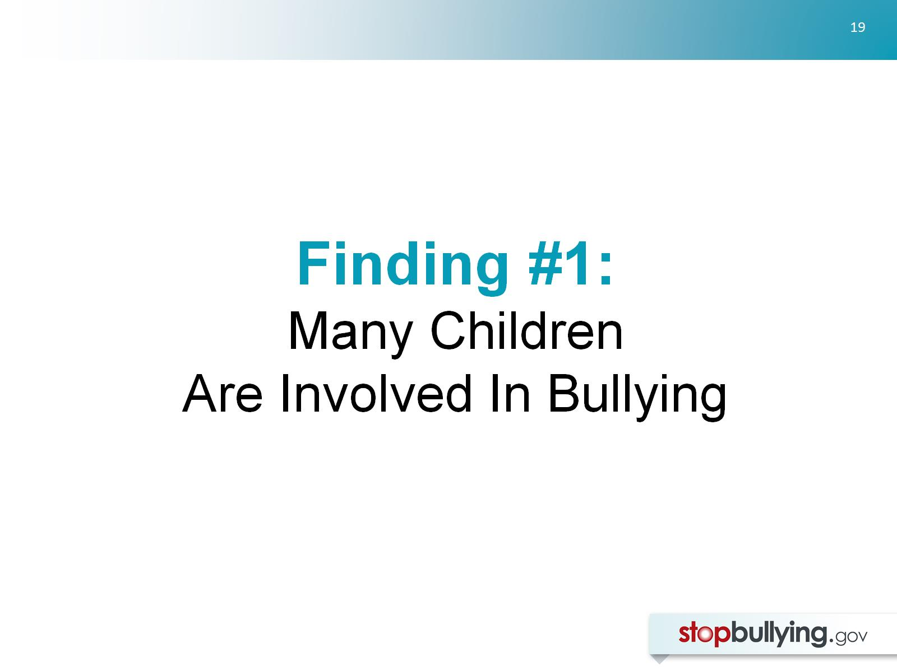
Finding #1:
Many Children
Are Involved In Bullying

Slide 20
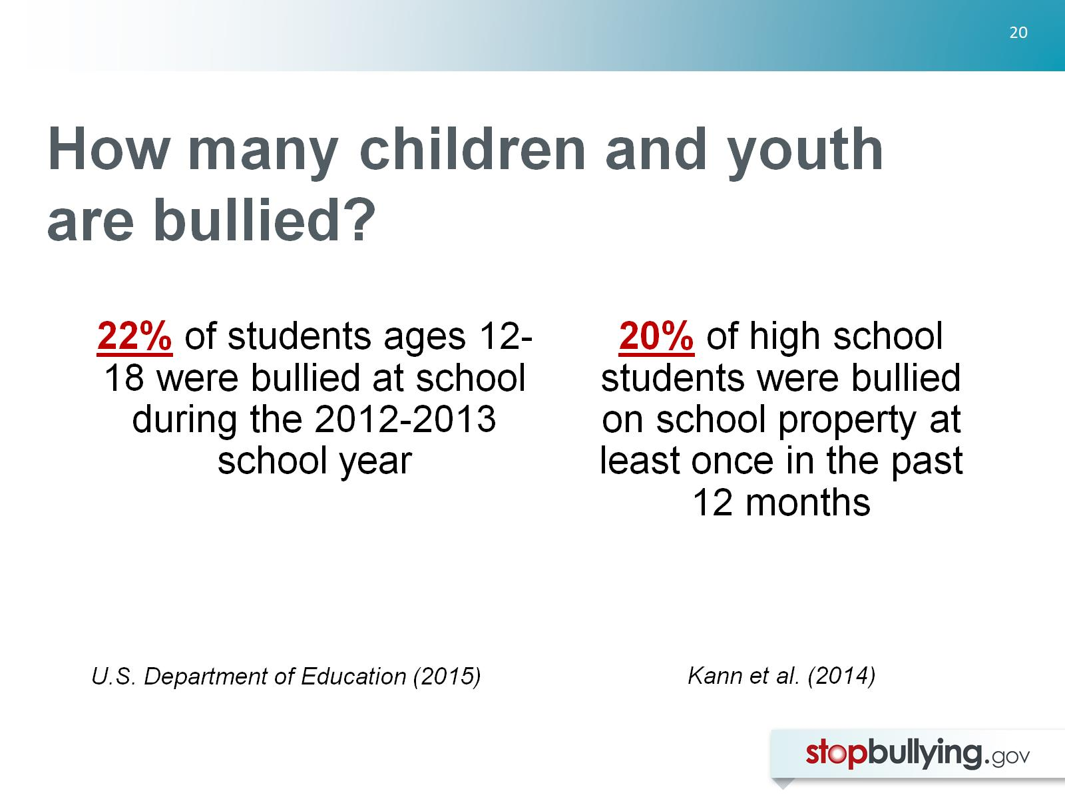
How many children and youth are bullied?

Slide 21
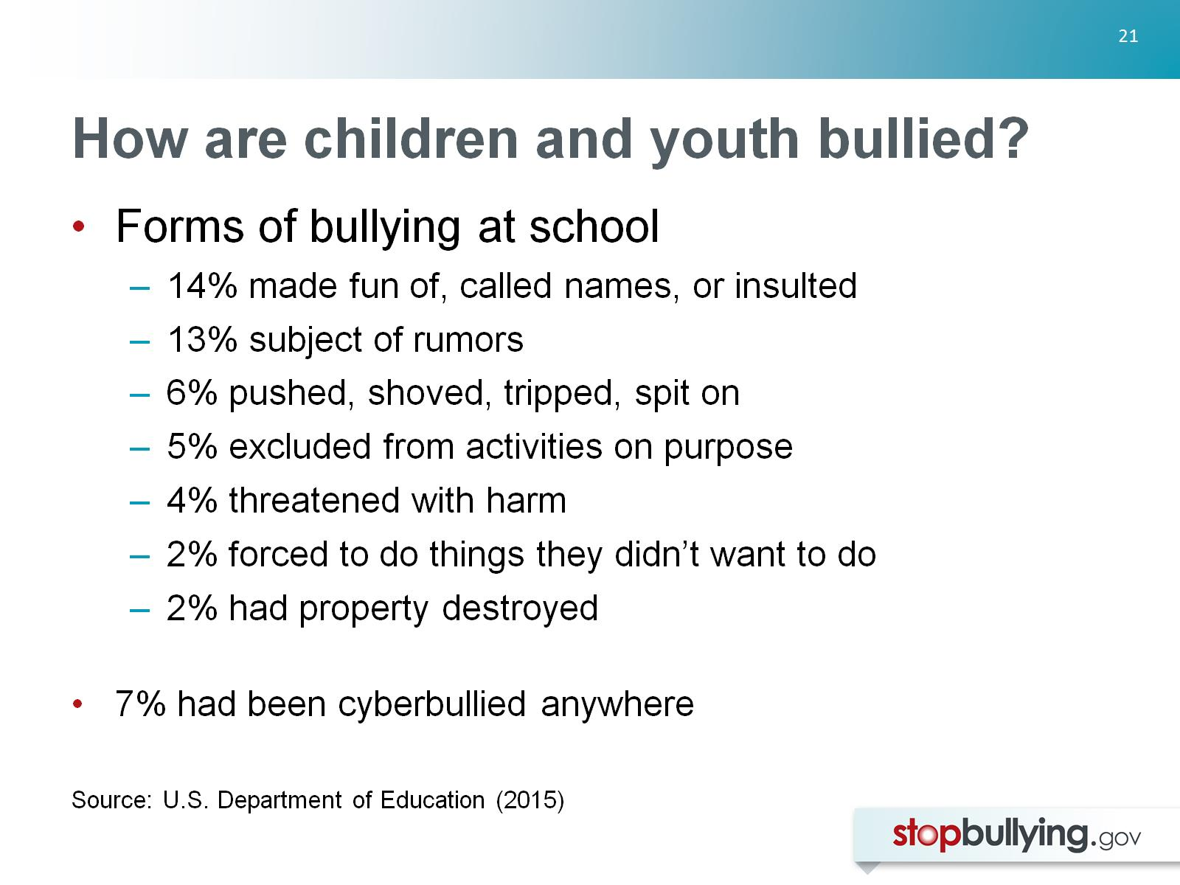
How are children and youth bullied?

Slide 22
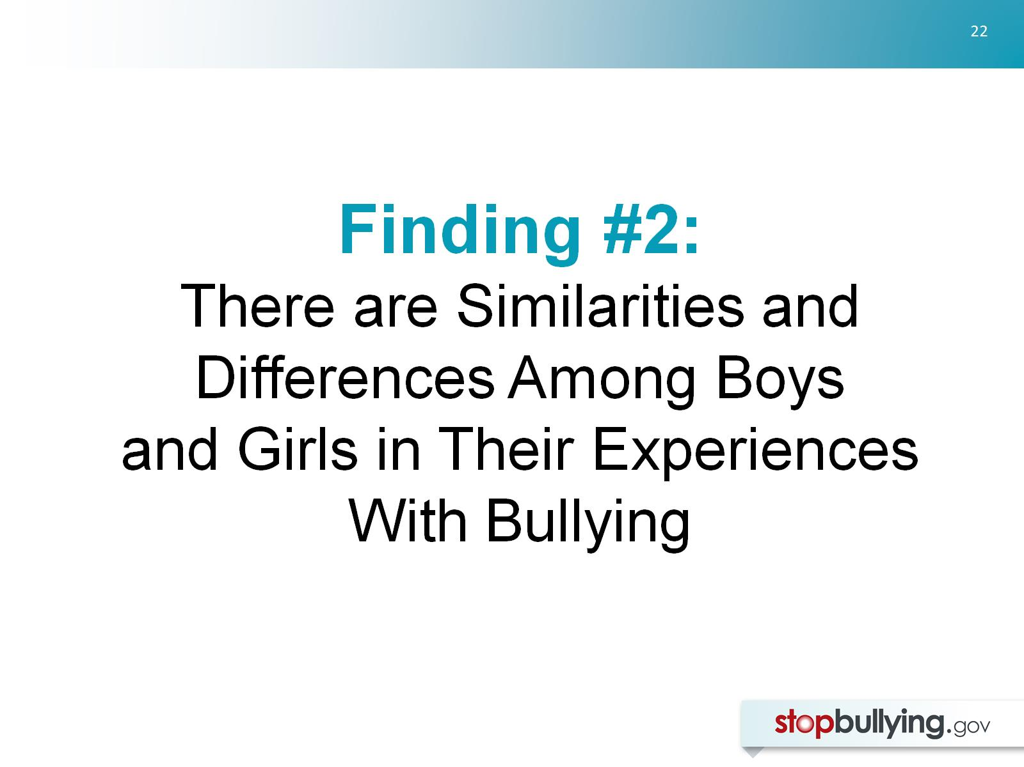
Finding #2:
There are Similarities and Differences Among Boys and Girls in Their Experiences With Bullying

Slide 23
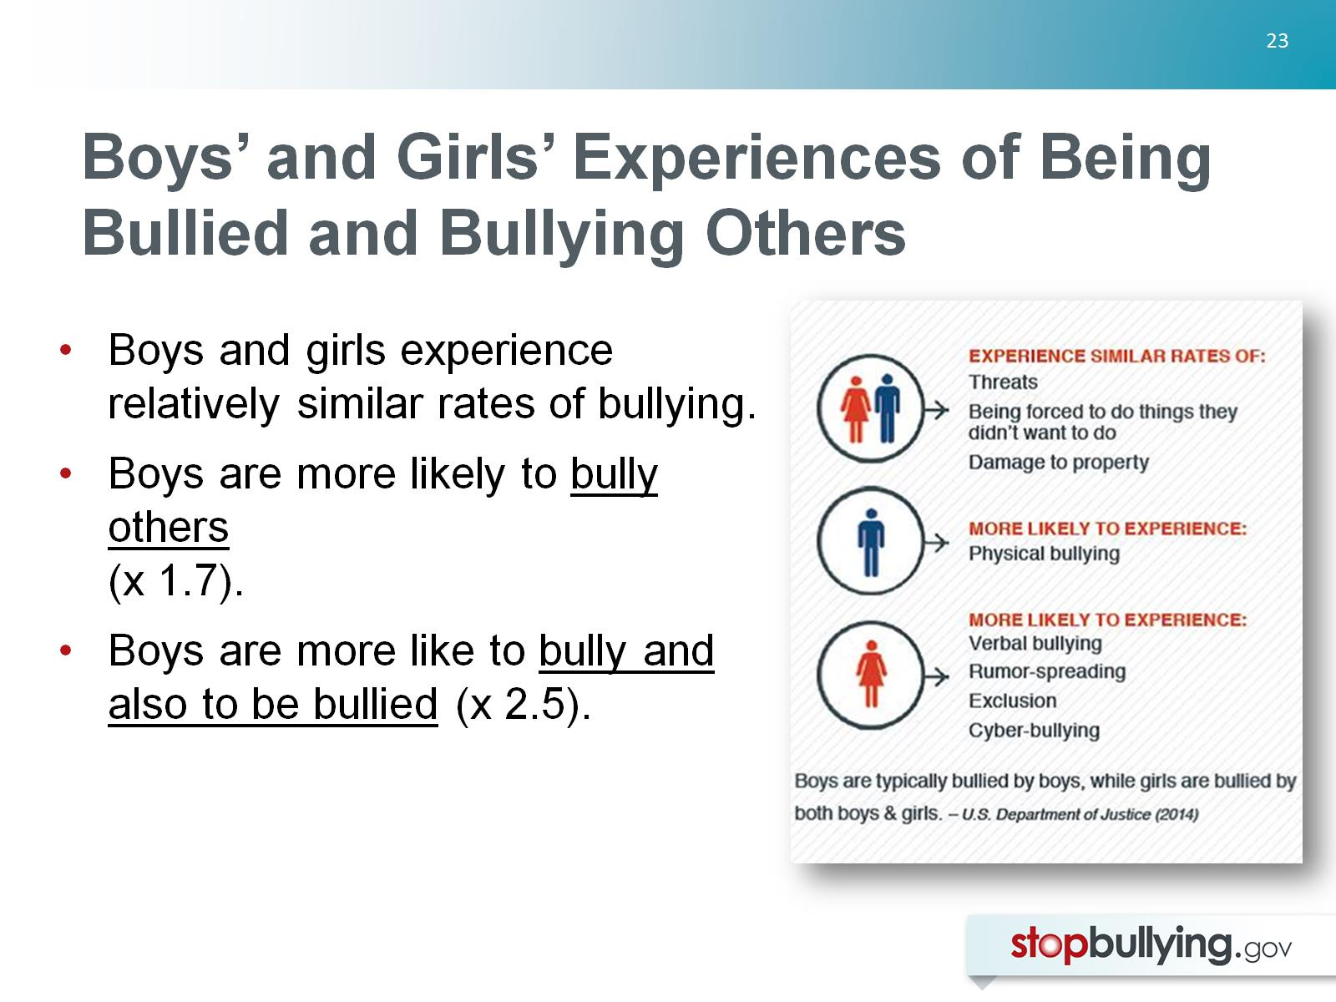
Boys’ and Girls’ Experiences of Being Bullied and Bullying Others

Slide 24
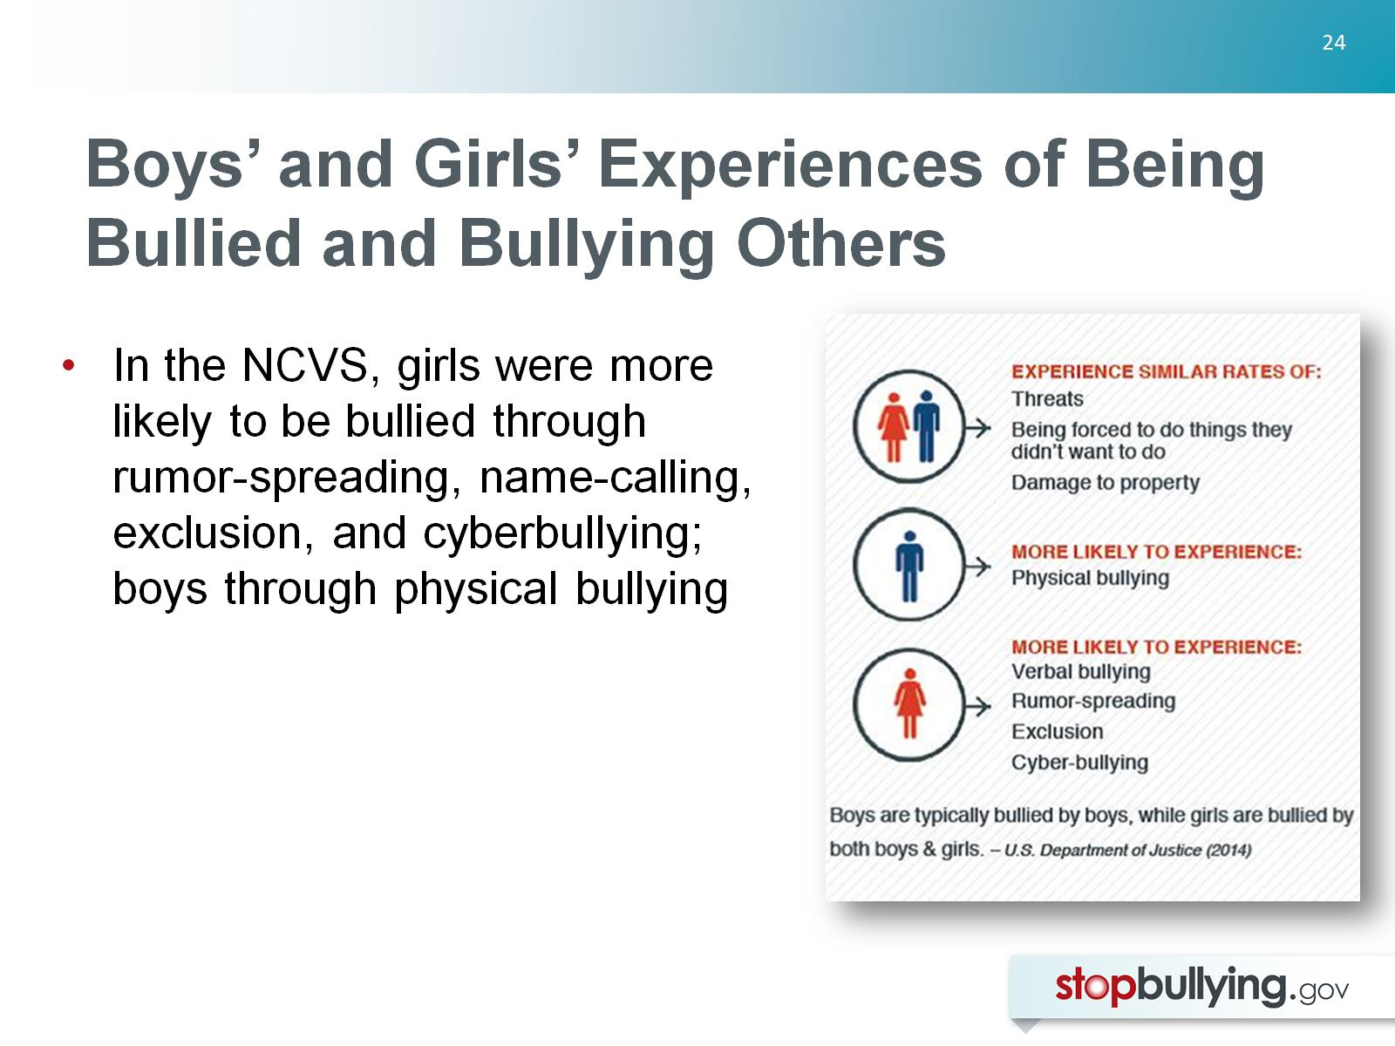
Boys’ and Girls’ Experiences of Being Bullied and Bullying Others

Slide 25
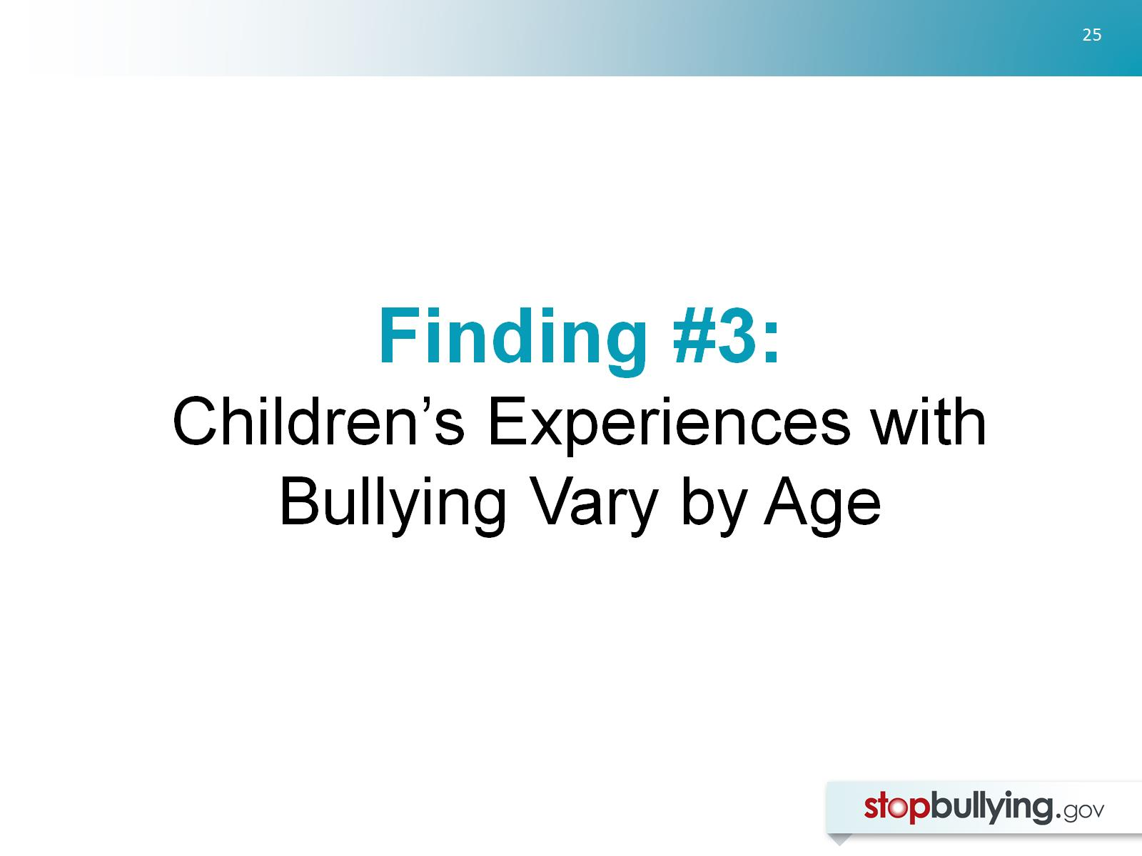
Finding #3:
Children’s Experiences with Bullying Vary by Age

Slide 26
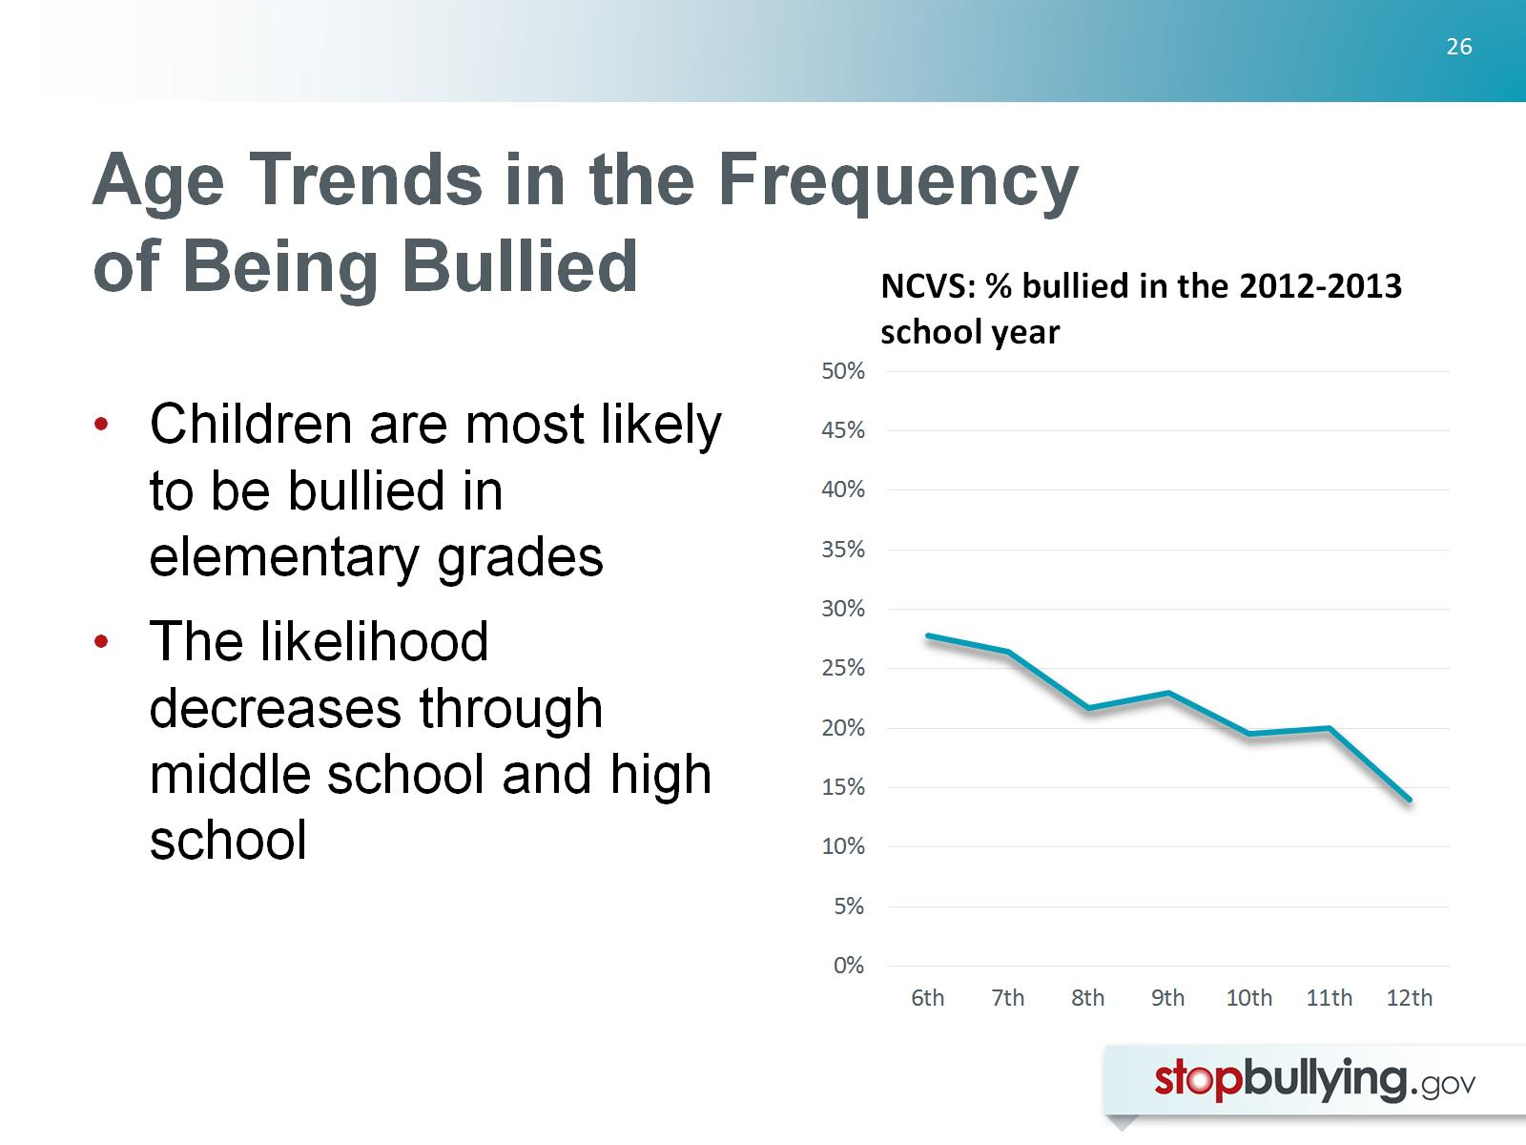
Age Trends in the Frequency of Being Bullied

Slide 27
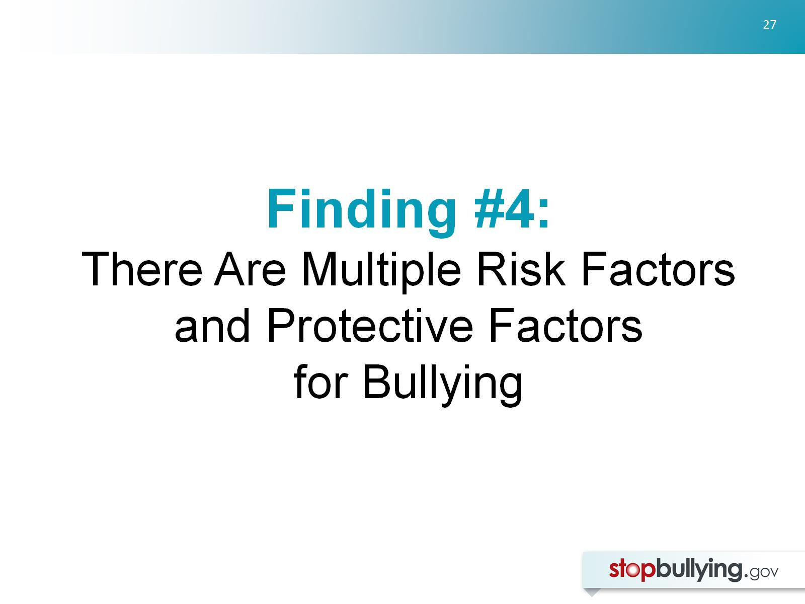
Finding #4:
There Are Multiple Risk Factors and Protective Factors for Bullying

Slide 28
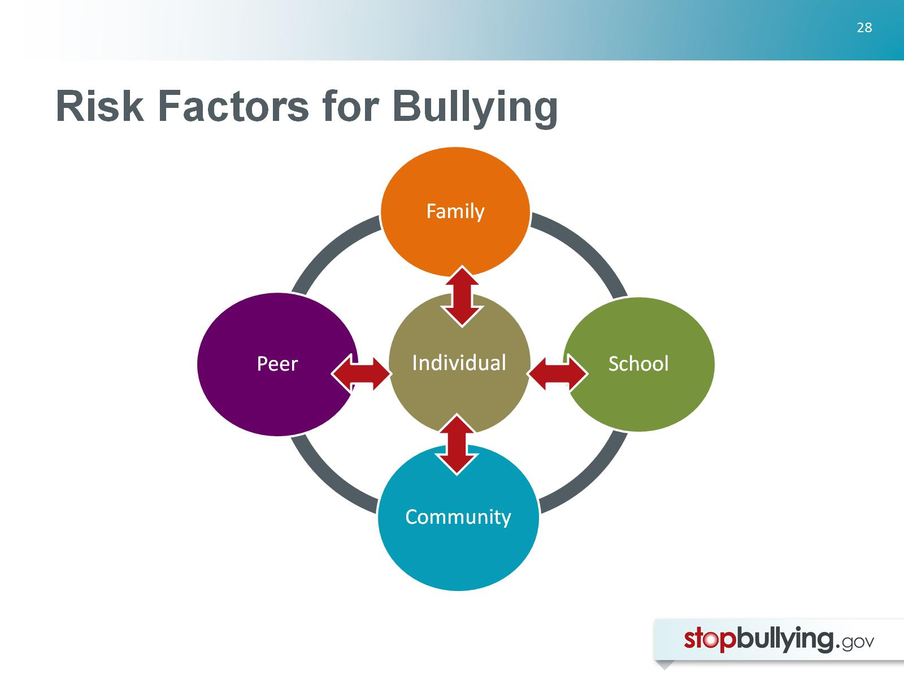
Risk Factors for Bullying

Slide 29
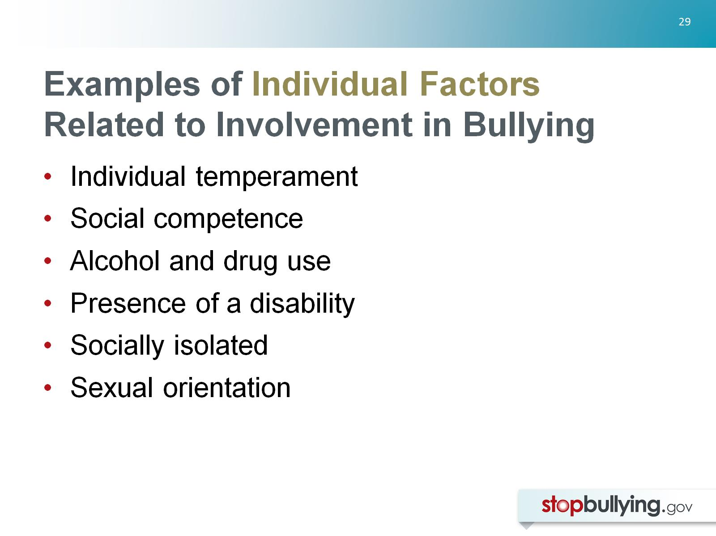
Examples of Individual Factors
Related to Involvement in Bullying

Slide 30
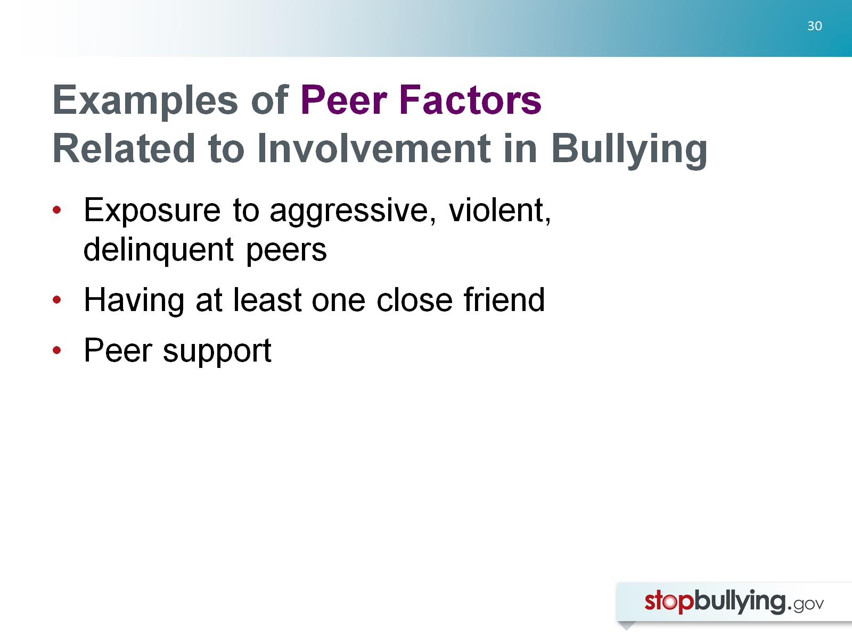
Examples of Peer Factors
Related to Involvement in Bullying

Slide 31
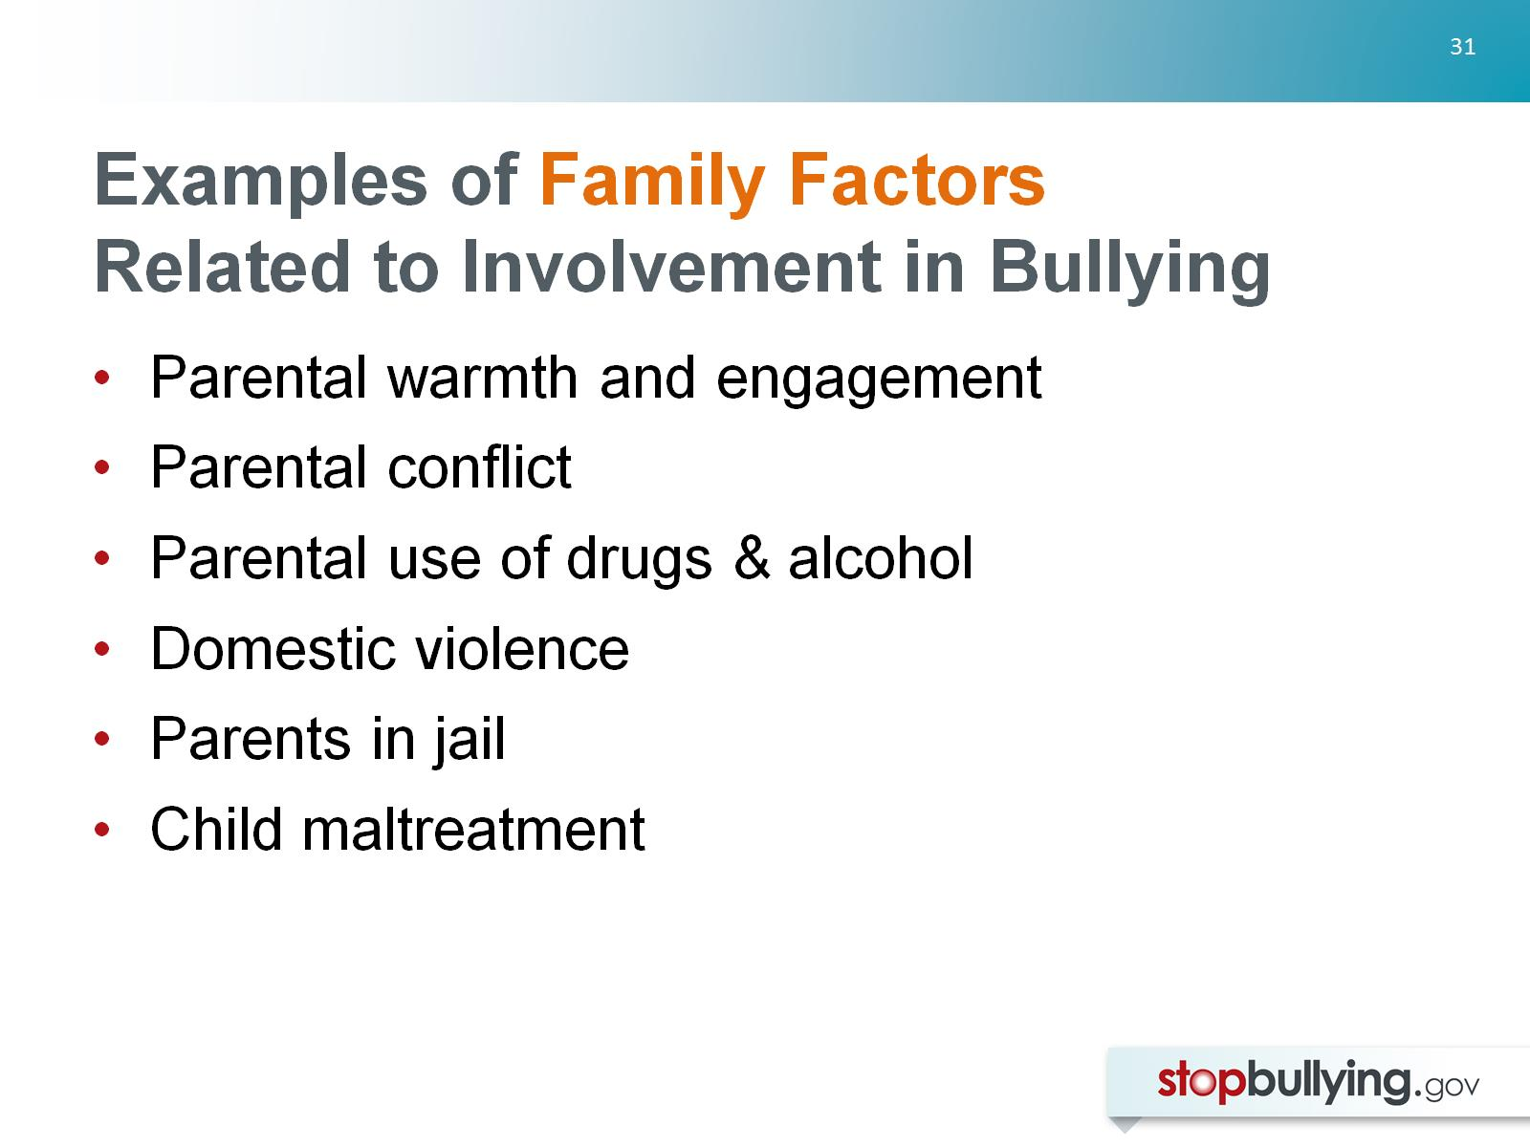
Examples of Family Factors
Related to Involvement in Bullying

Slide 32
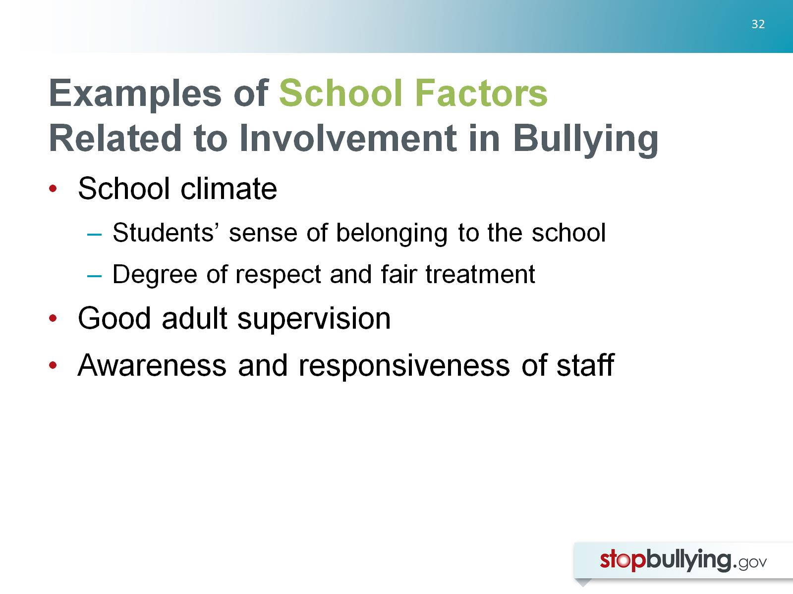
Examples of School Factors
Related to Involvement in Bullying

Slide 33
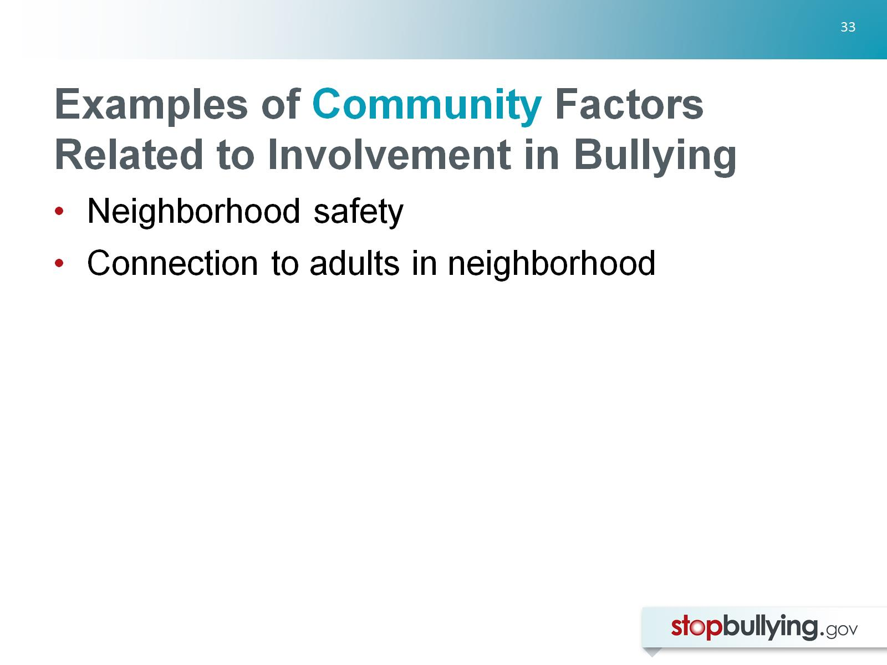
Examples of Community Factors Related to Involvement in Bullying

Slide 34
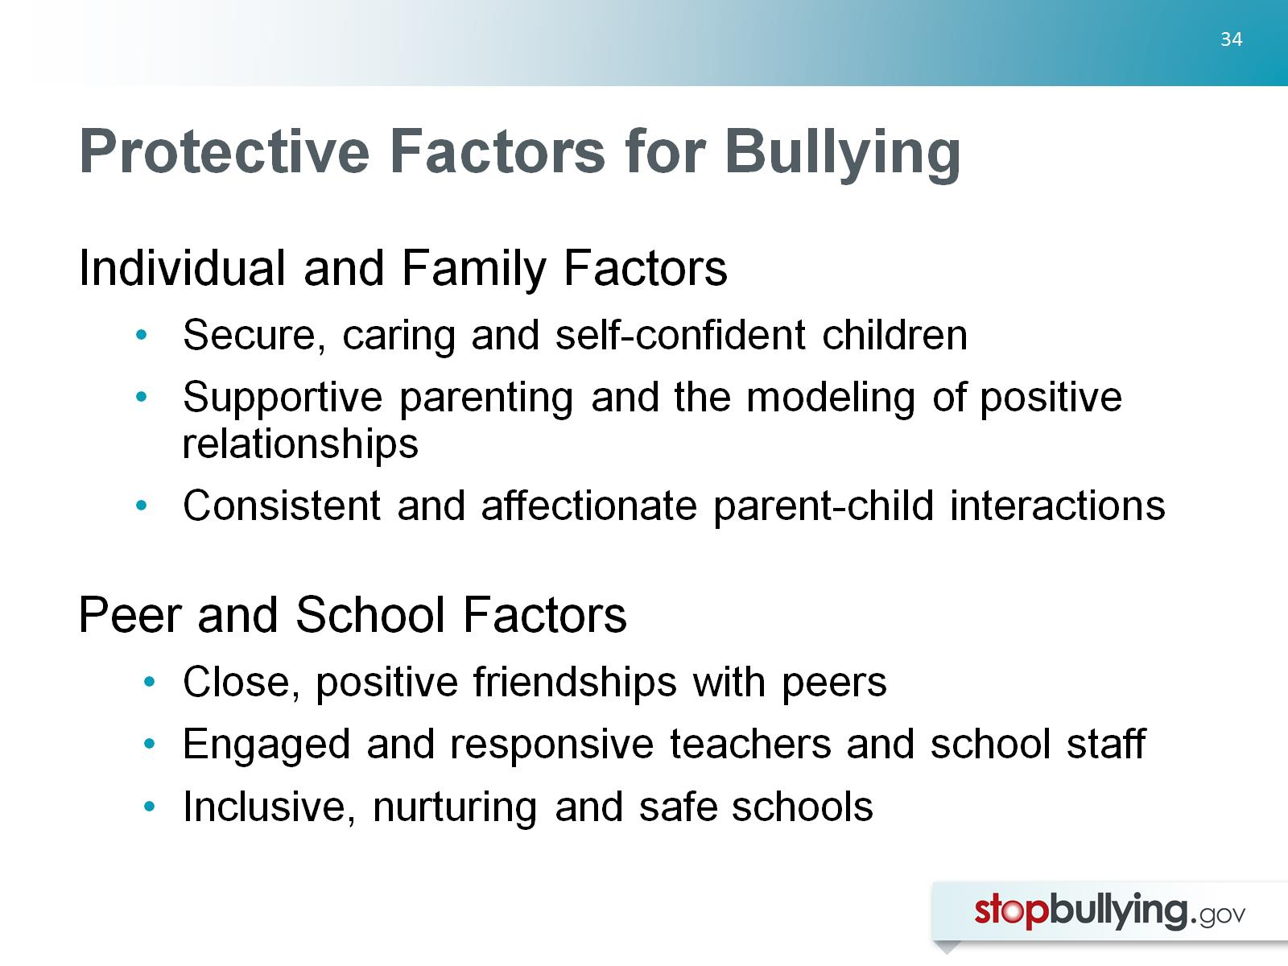
Protective Factors for Bullying

Slide 35
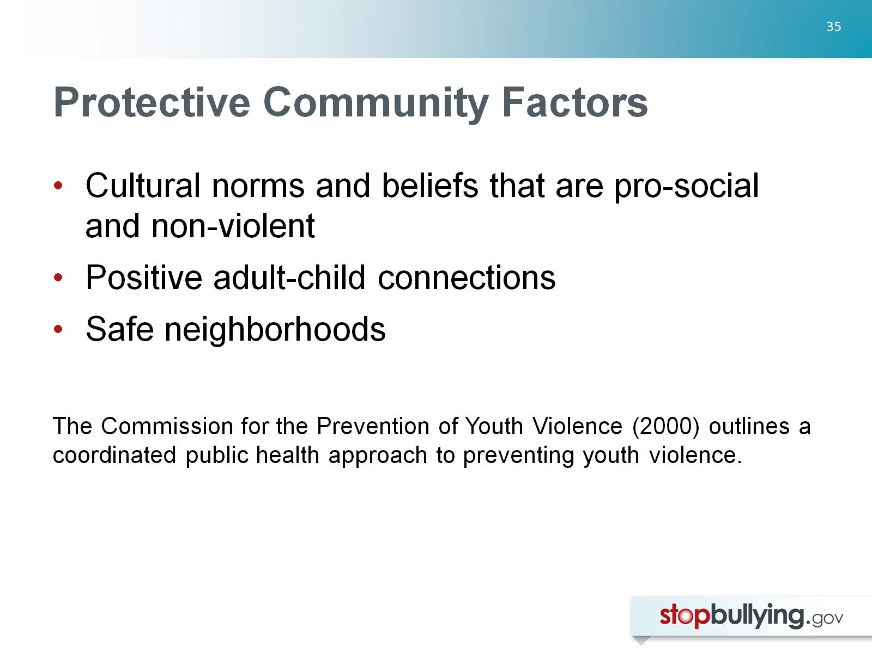
Protective Community Factors

Slide 36
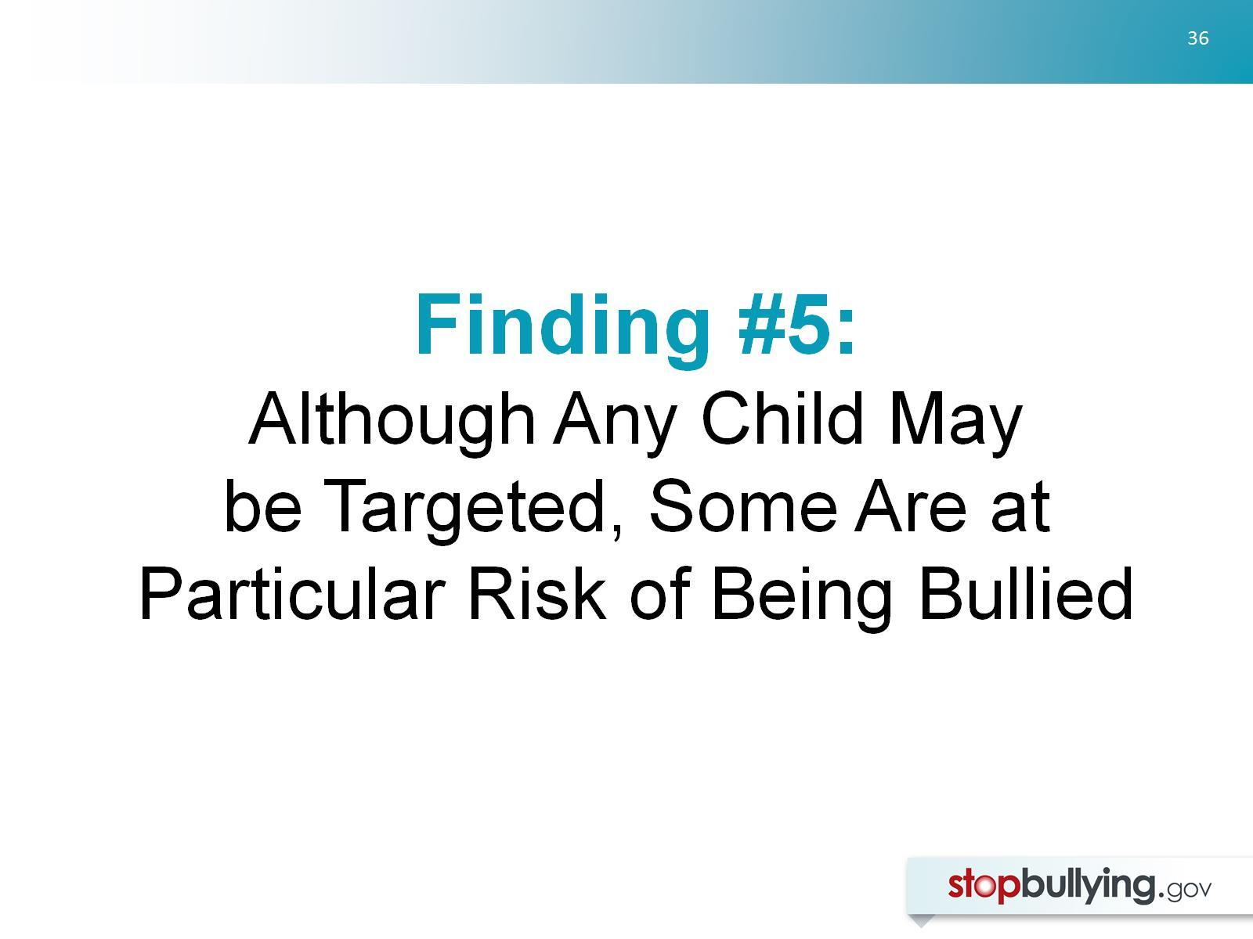
Finding #5:
Although Any Child May be Targeted, Some Are at Particular Risk of Being Bullied

Slide 37
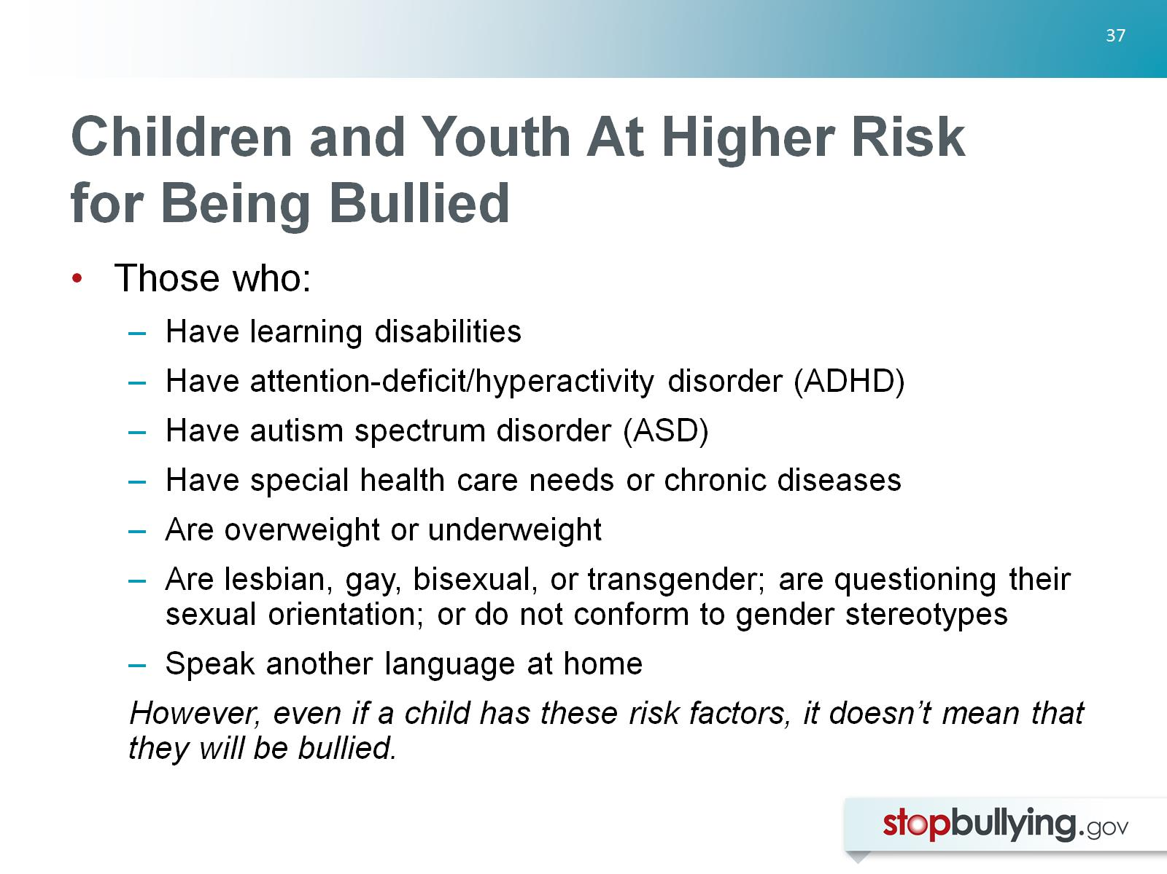
Children and Youth At Higher Risk for Being Bullied

Slide 38
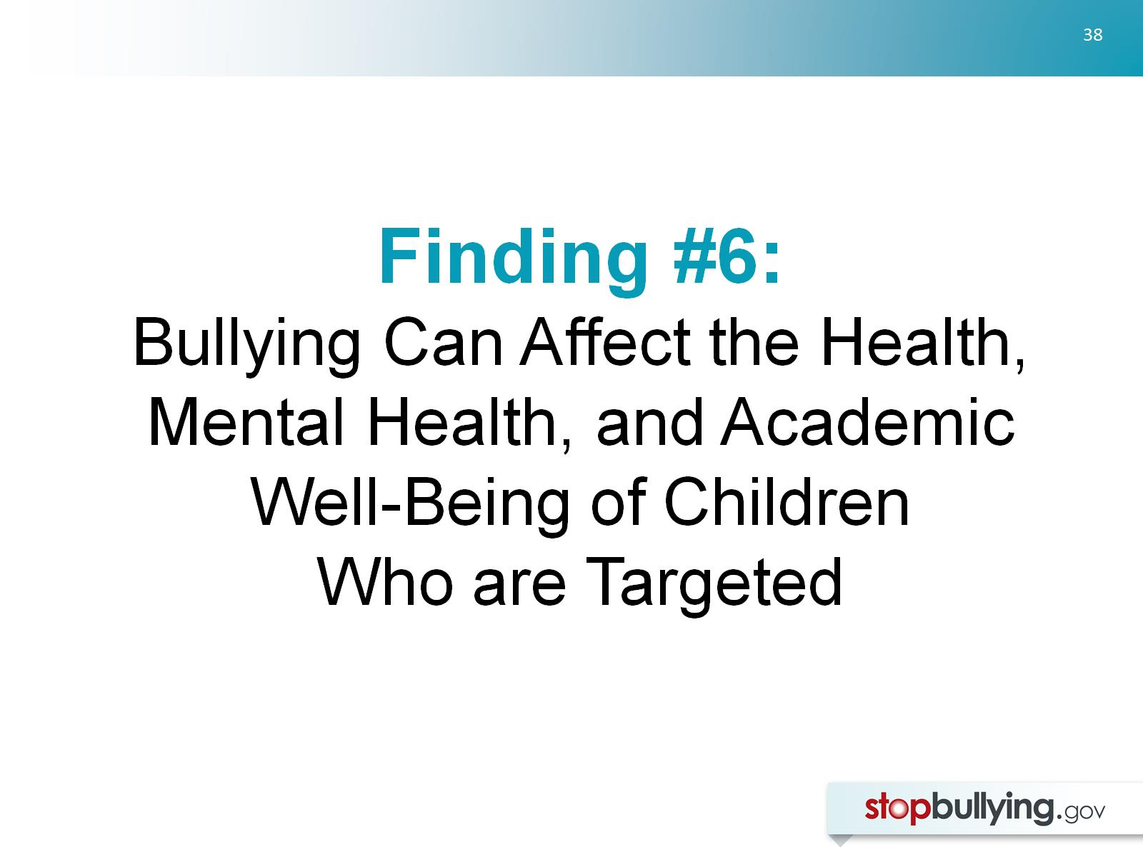
Finding #6:
Bullying Can Affect the Health, Mental Health, and Academic Well-Being of Children
Who are Targeted

Slide 39
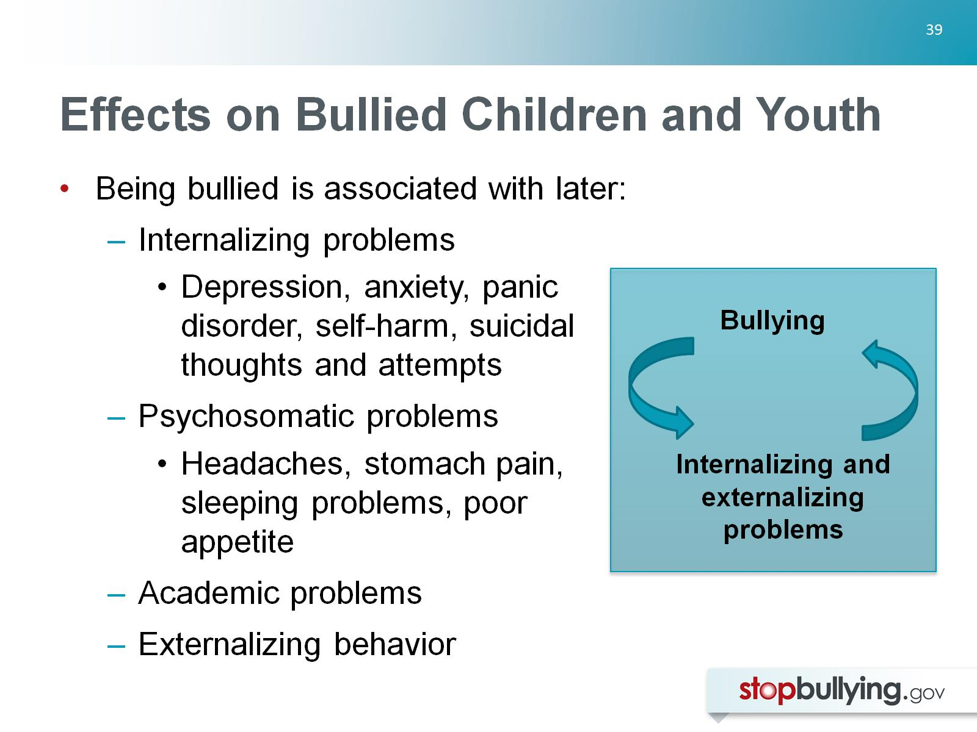
Effects on Bullied Children and Youth

Slide 40
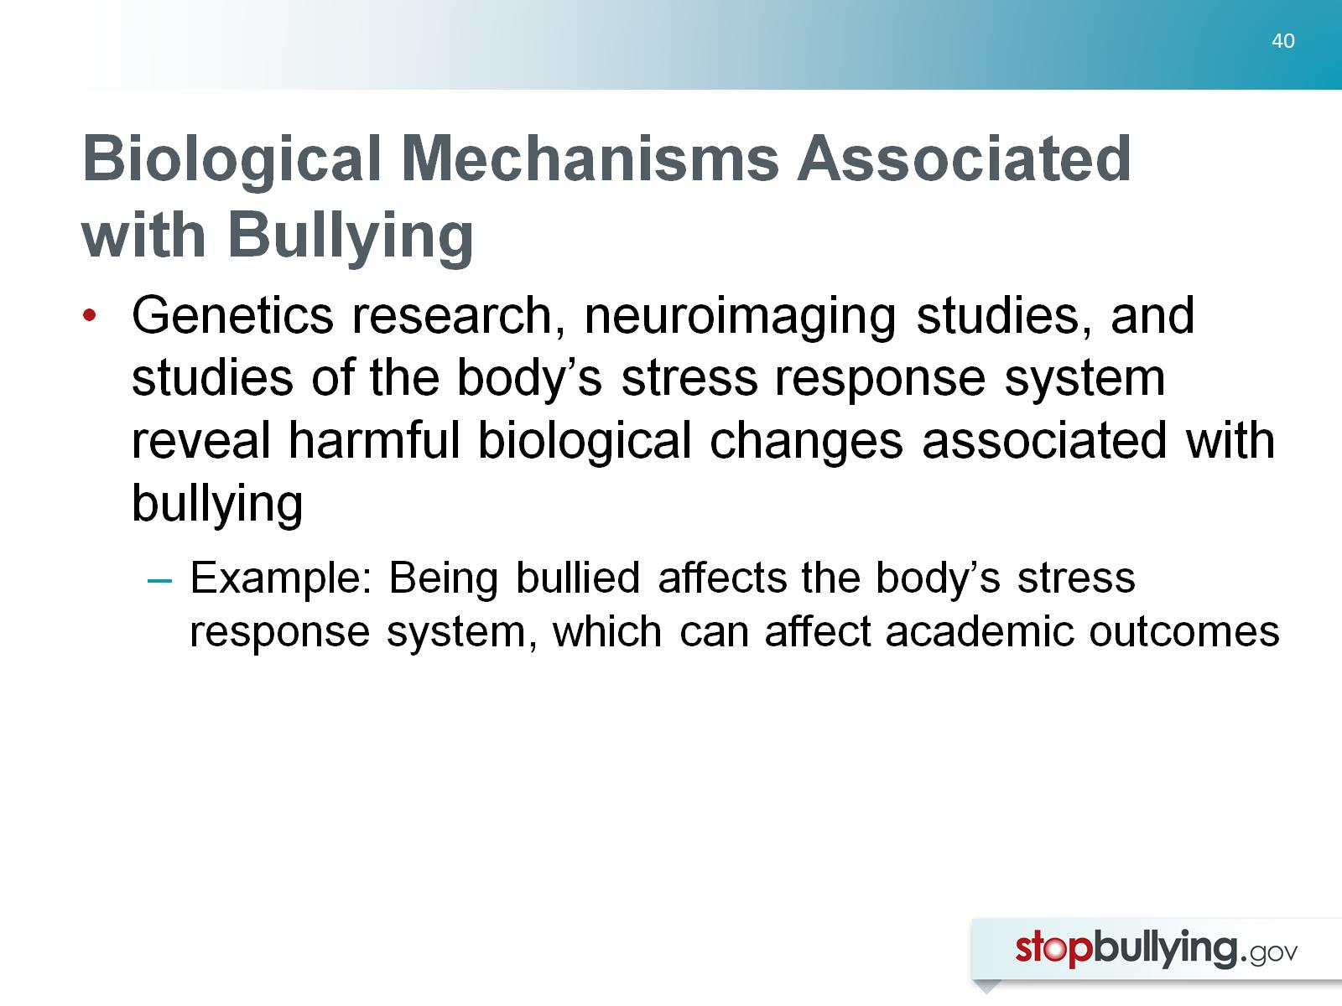
Biological Mechanisms Associated with Bullying

Slide 41
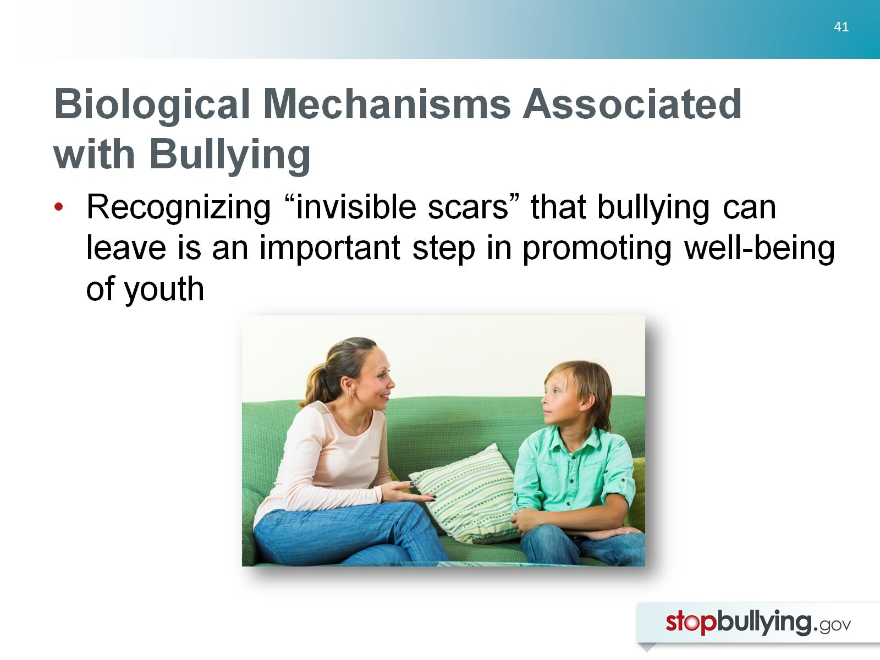
Biological Mechanisms Associated with Bullying

Slide 42
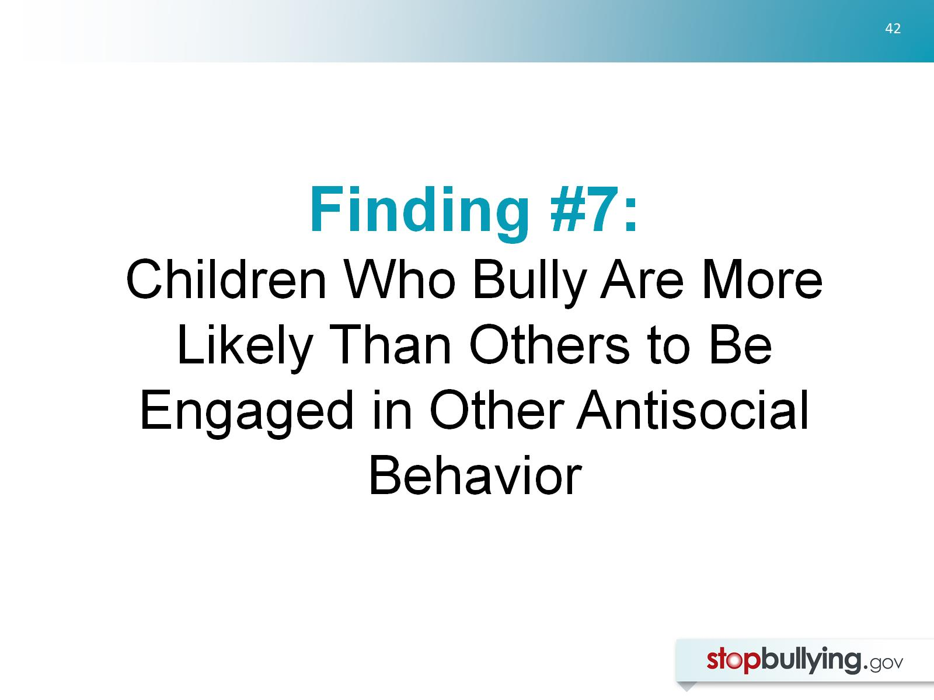
Finding #7:
Children Who Bully Are More Likely Than Others to Be Engaged in Other Antisocial Behavior

Slide 43
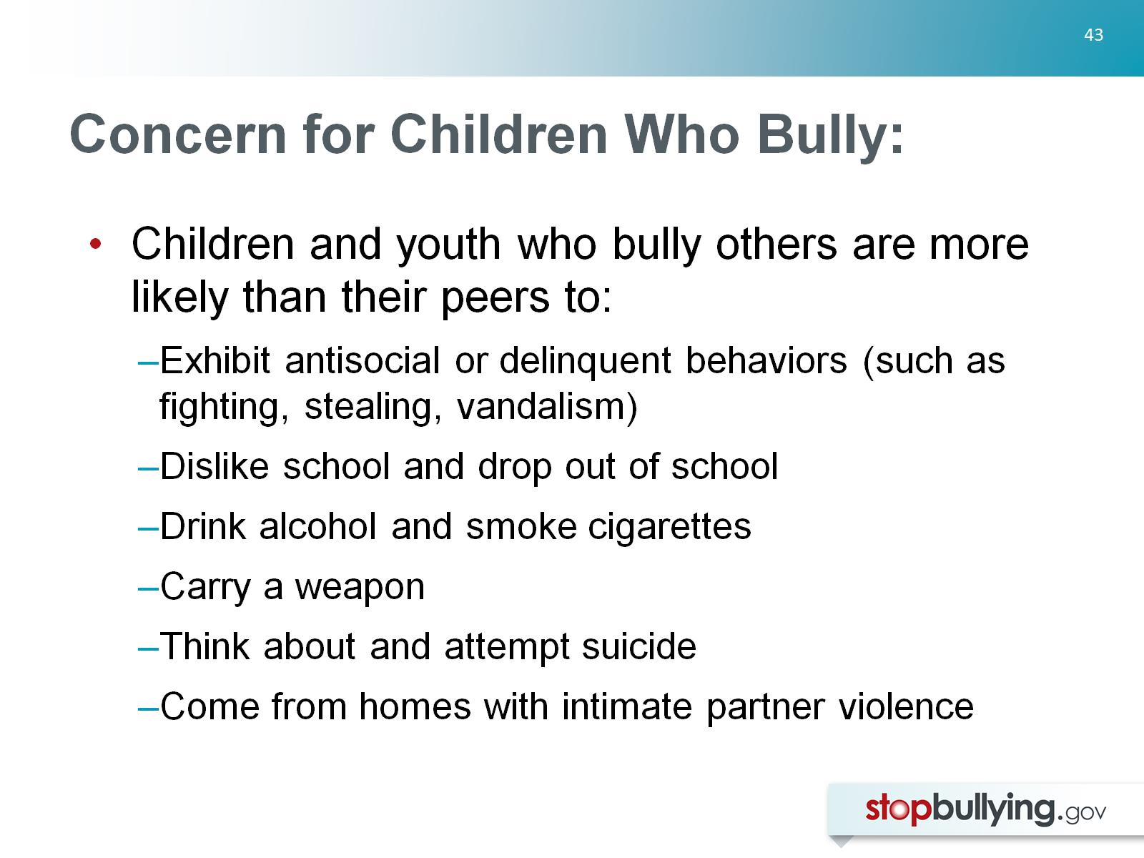
Concern for Children Who Bully:

Slide 44
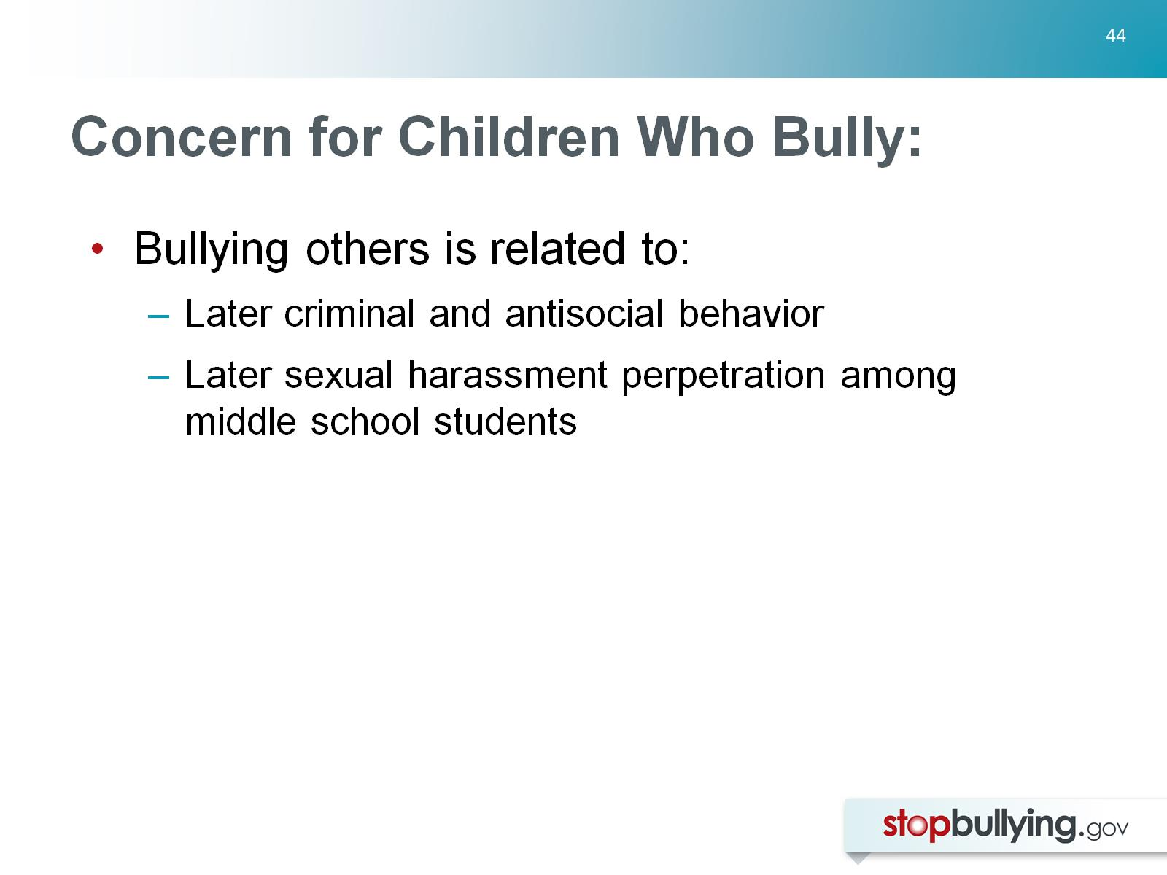
Concern for Children Who Bully:

Slide 45
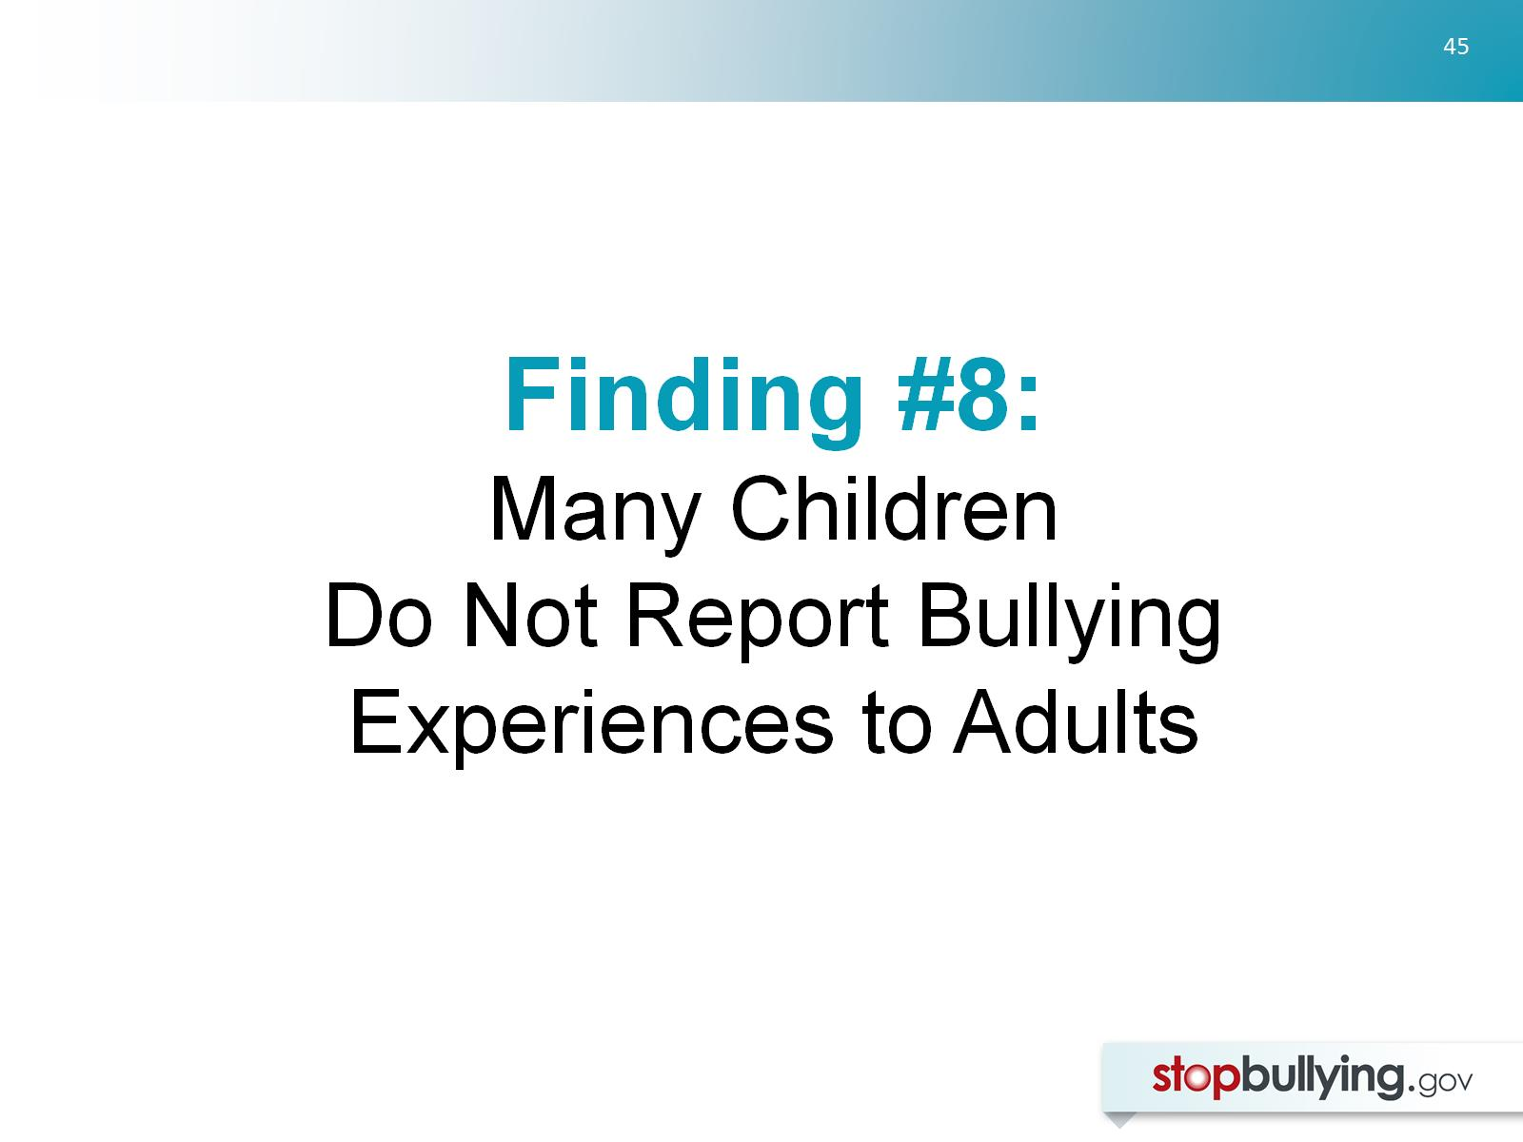
Finding #8:
Many Children
Do Not Report Bullying Experiences to Adults

Slide 46
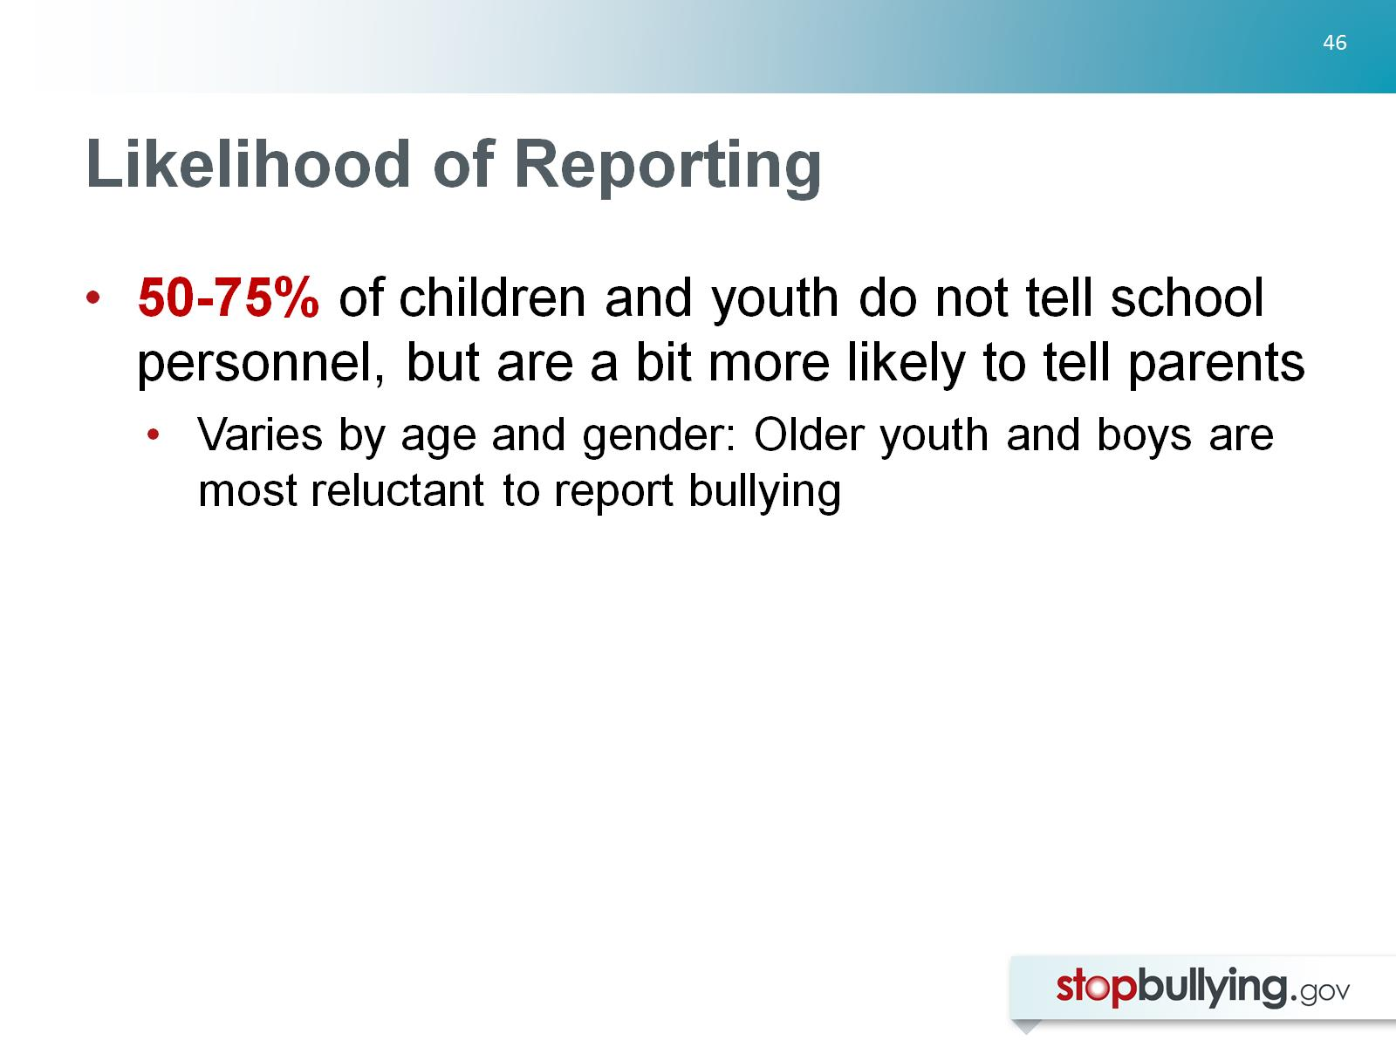
Likelihood of Reporting

Slide 47
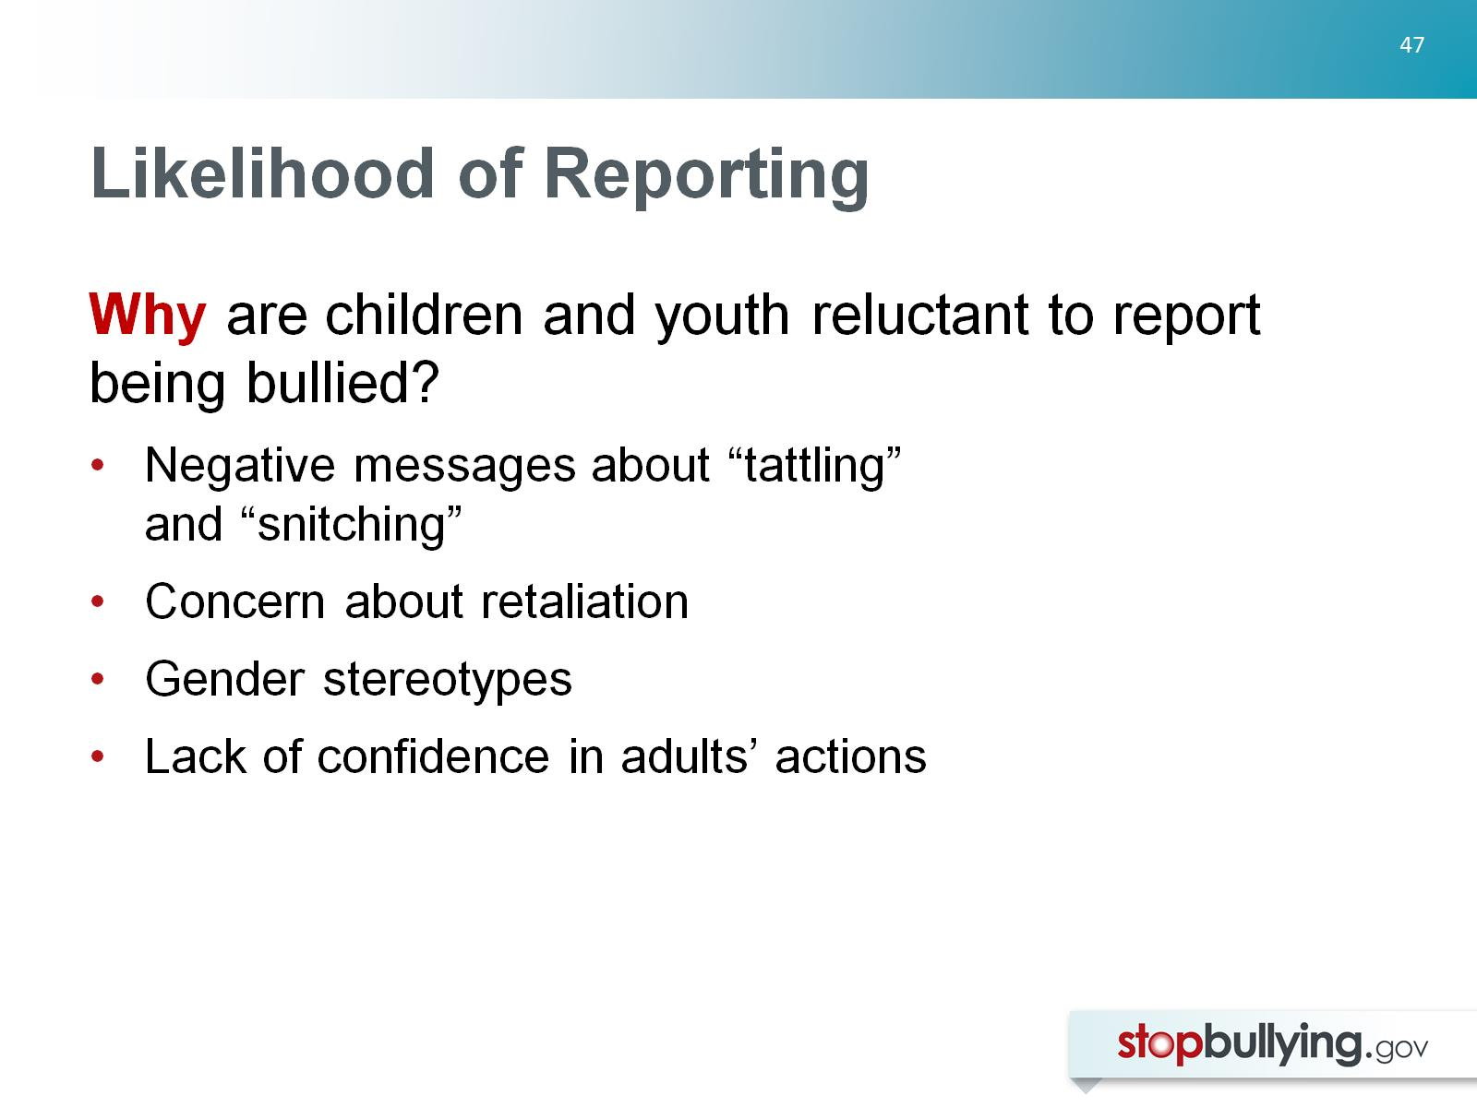
Likelihood of Reporting

Slide 48
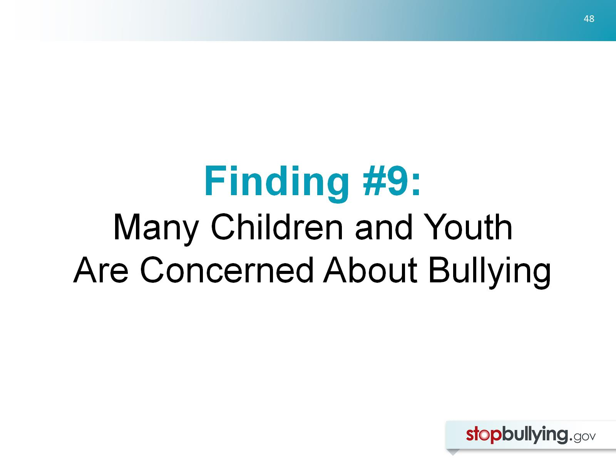
Finding #9:
Many Children and Youth
Are Concerned About Bullying

Slide 49
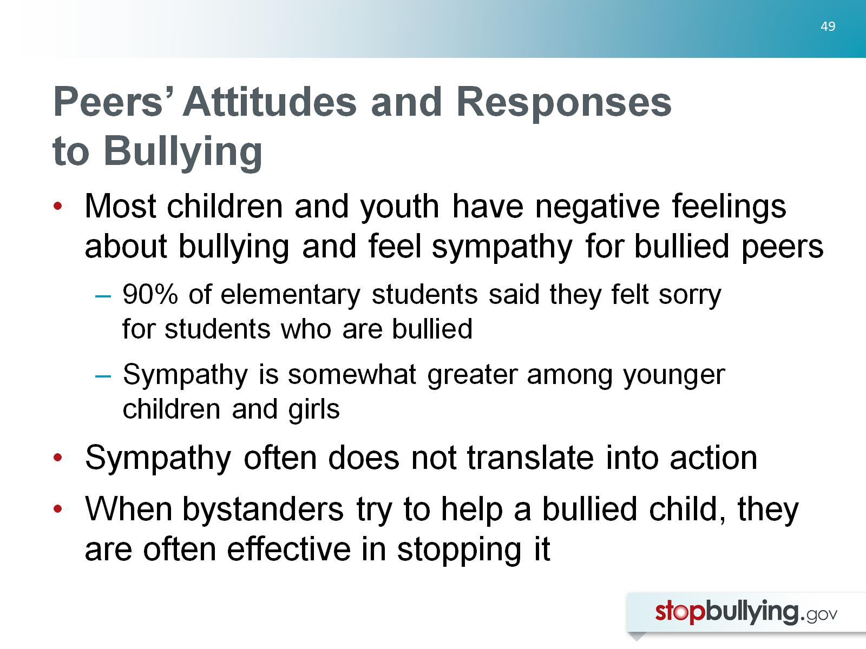
Peers’ Attitudes and Responses to Bullying

Slide 50
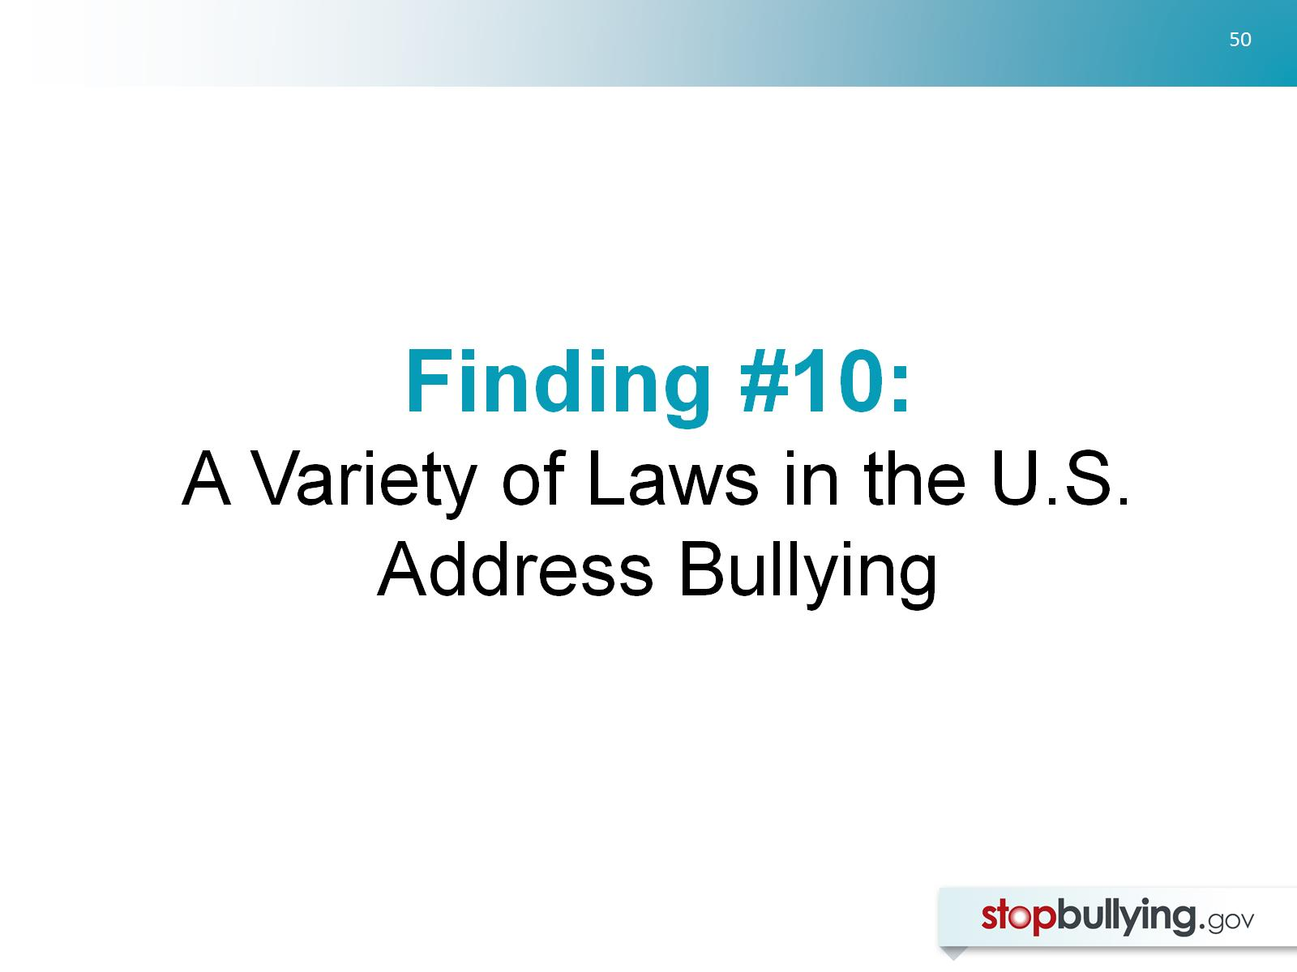
Finding #10:
A Variety of Laws in the U.S. Address Bullying

Slide 51
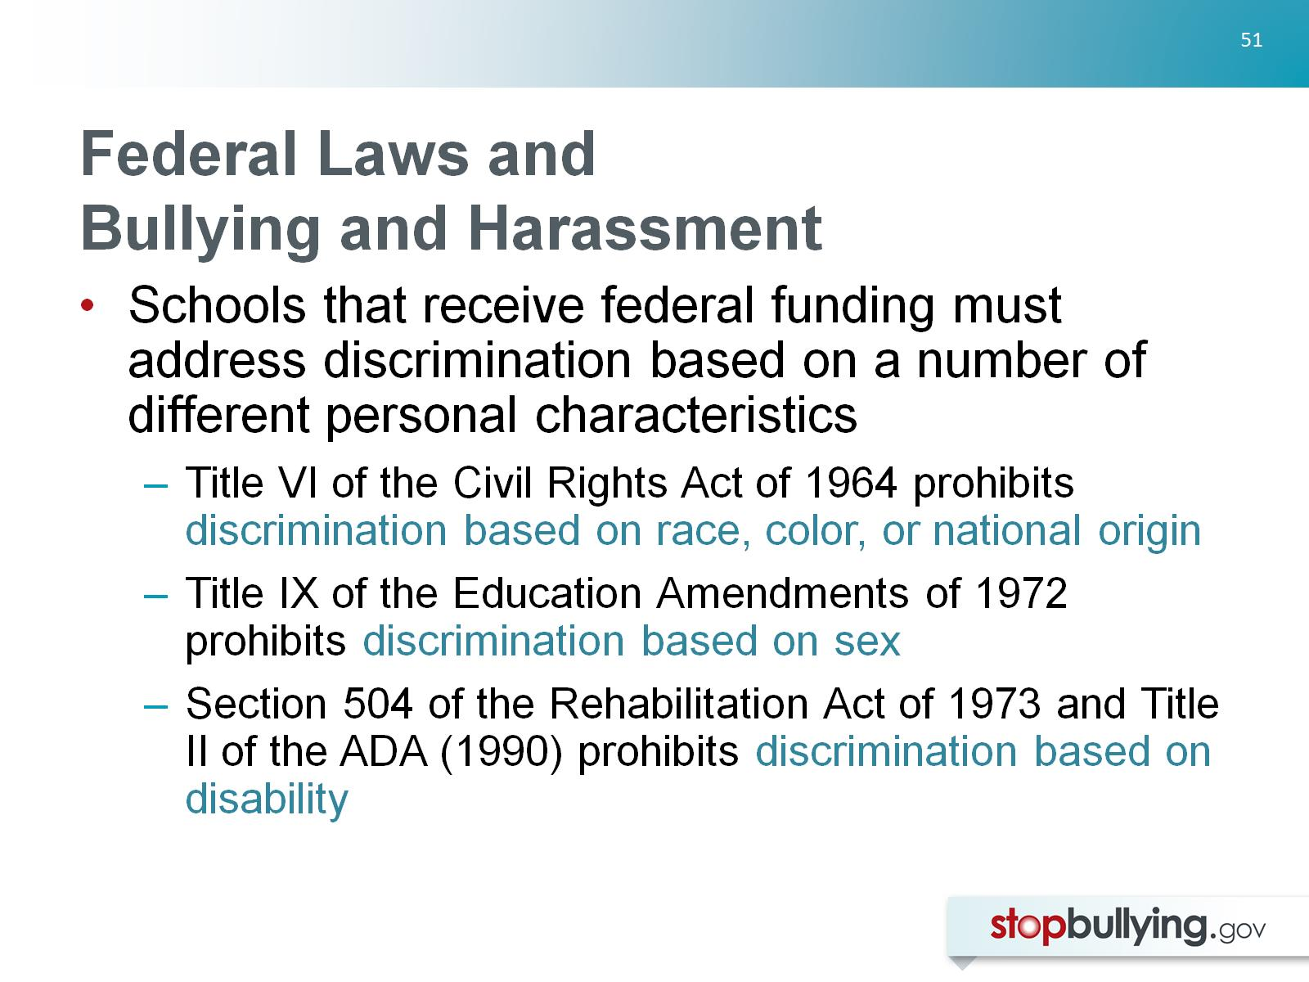
Federal Laws and
Bullying and Harassment

Slide 52

School Districts and Federal Civil Rights

Slide 53

State Anti-Bullying Laws and Policies

Slide 54

State Anti-Bullying Laws and Policies

Slide 55

Chapter Check-in:

Slide 56

Chapter Check-in:

Slide 57


Slide 58

Misdirection #1:
Zero Tolerance for Bullying

Slide 59

Misdirection #2: Conflict Resolution and Peer Mediation

Slide 60

Misdirection #2: Conflict Resolution and Peer Mediation

Slide 61

Misdirection #3:
Group Therapeutic Treatment

Slide 62

Misdirection #4: Overstating or Simplifying the Relationship Between Bullying and Suicide

Slide 63

Misdirection #4: Overstating or Simplifying the Relationship Between Bullying and Suicide

Slide 64

Misdirection #5: Simple, Short-Term Solutions

Slide 65

Chapter Check-in:

Slide 66

Chapter Check-in:

Slide 67


Slide 68

#1: Focus on the Social Climate

Slide 69

#2: Conduct Community-Wide
Assessments of Bullying

Slide 70

#3: Seek Out Support for Bullying Prevention

Slide 71

#4: Coordinate and Integrate Prevention Efforts

Slide 72

#4: Coordinate and Integrate Prevention Efforts

Slide 73

#4: Coordinate and Integrate Prevention Efforts

Slide 74

#5: Provide Training in Bullying Prevention and Response

Slide 75

#5: Provide Training in Bullying Prevention and Response

Slide 76

#5: Provide Training in Bullying Prevention and Response

Slide 77

#5: Provide Training in Bullying Prevention and Response

Slide 78

#6: Organize a Community Event to Catalyze Efforts

Slide 79

#6: Organize a Community Event to Catalyze Efforts

Slide 80

#6: Organize a Community Event to Catalyze Efforts

Slide 81

#6: Organize a Community Event to Catalyze Efforts

Slide 82

#7: Set Policies and Rules About Bullying

Slide 83

#8: Respond Consistently and Appropriately When Bullying Happens

Slide 84

#8: Respond Consistently and Appropriately When Bullying Happens

Slide 85

#8: Respond Consistently and Appropriately When Bullying Happens

Slide 86

#8: Respond Consistently and Appropriately When Bullying Happens

Slide 87

#9: Spend Time Talking with Children and Youth About Bullying

Slide 88

#9: Spend Time Talking with Children and Youth About Bullying

Slide 89

#9: Spend Time Talking with Children and Youth About Bullying

Slide 90

#9: Spend Time Talking with Children and Youth About Bullying

Slide 91

#10: Continue Efforts Over Time and Renew Community Interests

Slide 92

Chapter Check-in:

Slide 93

In Conclusion

Slide 94

References
Ali, R. (2010) U. S. Department of Education, Office for Civil Rights (2010). Dear colleague letter: Harassment and bullying. Retrieved from http://www2.ed.gov/about/offices/list/ocr/letters/colleague-201010.pdf
American Psychological Association Zero Tolerance Task Force (2008). Are zero tolerance policies effective in the schools? An evidentiary review and recommendations. American Psychologist, 63, 852-862.
Arsenault, L., Walsh, E., Trzesniewski, K., Newcombe, R., Caspi, A. and Moffitt, E. (2006) Bullying victimization uniquely contributes to adjustment problems in young children: A nationally representative cohort study, Pediatrics, 118, 130-138.
Baldry, A. C. (2003). Bullying in schools and exposure to domestic violence. Child Abuse & Neglect, 27, 713-732.

Slide 95

Baldry, A. C. (2004). The impact of direct and indirect bullying on the mental and physical health of Italian youngsters. Aggressive Behavior, 30, 343-355.
Baldry, A. C., & Farrington, D. P. (2005). Protective factors as moderators of risk factors in adolescence bullying. Social Psychology of Education, 8, 263-284.
Berthold, K. A., & Hoover, J. H. (2000). Correlates of bullying and victimization among intermediate students in the Midwestern USA. School Psychology International, 21, 65-78.
Boulton, M. J., & Underwood, K. (1992). Bully/victim problems among middle school children. British Journal of Educational Psychology, 62, 73-87.
Bowes, L., Arseneault, L., Maughan, B., Taylor, A., Caspi, A., & Moffitt, T. E. (2009). School, neighborhood, and family factors are associated with children's bullying involvement: A nationally representative longitudinal study. Journal of the American Academy of Child & Adolescent Psychiatry, 48, 545-553.

Slide 96

Buhs, E. S., Ladd, G. W., & Herald, S. L. (2006). Peer exclusion and victimization: Processes that mediate the relation between peer group rejection and children's classroom engagement and achievement? Journal of educational psychology, 98, 1-13.
Byrne, B. J. 1994. Bullies and victims in school settings with reference to some Dublin schools. Irish Journal of Psychology,15, 574-86.
Centers for Disease Control and Prevention. (2012a). Suicide: Facts at a glance. Retrieved from: http://www.cdc.gov/ViolencePrevention/pdf/Suicide_DataSheet-a.pdf
Commission for the Prevention of Youth Violence. (2000). Youth and violence: Medicine, nursing, and public health: Connecting the dots to prevent violence.
Cook, C. R., Williams, K. R., Guerra, N. G., & Kim, T. E. (2010). Variability in the prevalence of bullying and victimization: A cross-national and methodological analysis. In S. R. Jimerson, S. M. Swearer, & D. L. Espelage (Eds.), Handbook of bullying in schools: An international perspective (pp. 347-362). New York: Routledge.

Slide 97

Cook, C. R., Williams, K. R., Guerra, N. G., Kim, T. E., & Sadek, S. (2010). Predictors of bullying and victimization in childhood and adolescence: A meta-analytic investigation. School Psychology Quarterly, 25, 65-83.
Copeland, W. E., Wolke, D., Angold, A., & Costello, E. J. (2013). Adult psychiatric outcomes of bullying and being bullied by peers in childhood and adolescence. JAMA Psychiatry, 70, 419-426.
Cornell, D., & Limber, S. P. (2015). Law and policy on the concept of bullying at school. American Psychologist, 70, 333-343.
Dawkins, J. L. (1996). Bullying, physical disability and the paediatric patient. Developmental Medicine & Child Neurology, 38, 603-612.
Dishion, T. J., McCord, J., & Poulin, F. (1999). When interventions harm: Peer groups and problem behavior. American Psychologist, 54, 755-764.

Slide 98

Durlak, J. A., Weissberg, R. P., Dymnicki, A. B., Taylor, R. D., & Schellinger, K. B. (2011). The impact of enhancing students’ social and emotional learning: A meta-analysis of school-based universal interventions. Child Development, 82, 405-432.
Espelage, D. L., & Swearer, S. M. (2010). A social-ecological model for bullying prevention and intervention. In S. R. Jimerson, S. M. Swearer, & D. L. Espelage (Eds.), Handbook of bullying in schools: An international perspective (pp. 61-72). New York: Routledge.
Espelage, D. L., Aragon, S. R., Birkett, M., & Koenig, B. W. (2008). Homophobic teasing, psychological outcomes, and sexual orientation among high school students: What influence do parents and schools have? School Psychology Review, 37, 202-216.
Espelage, D. L., Basile, K. C., & Hamburger, M. E. (2012). Bullying perpetration and subsequent sexual violence perpetration among middle school students. Journal of Adolescent Health, 50, 60-65.
Faris, R., & Felmlee, D. (2014). Casualties of social combat: School networks of peer victimization and their consequences. American Sociological Review, 79, 228-257.

Slide 99

Finkelhor, D., Turner, H., Ormrod, R., & Hamby, S. L. (2009). Violence, abuse, and crime exposure in a national sample of children and youth. Pediatrics, 124, 1411-1423.
Fonzi, A. Genta M.L., Menesini E., Bacchini D., Bonino S. & Costabile A. (1999). The nature of school bullying. In P.K. Smith, Y. Morita, J. Junger-Tas, D. Olweus, R. Catalano & P. Slee (Eds.). The nature of school bullying (pp. 174-187). London: Routledge
Gini, G. & Pozzoli, T. (2013). Bullied children and psychosomatic problems: A meta-analysis. Pediatrics, 132, 720-729.
Gladden, R. M., Vivolo-Kantor, A. M., Hamburger, M. E., & Lumpkin, C. D. (2014). Bullying surveillance among youths: Uniform definitions for public health and recommended data elements, version 1.0. Atlanta, GA: National Center for Injury Prevention and Control, Centers for Disease Control and Prevention and U.S. Department of Education.

Slide 100

Glew, G. M., Fan, M. Y., Katon, W., Rivara, F. P., & Kernic, M. A. (2005). Bullying, psychosocial adjustment, and academic performance in elementary school. Archives of Pediatrics & Adolescent Medicine, 159, 1026-1031.
Gray, W. N., Kahhan, N. A., & Janicke, D. M. (2009). Peer victimization and pediatric obesity: A review of the literature. Psychology in the Schools, 46, 720-727.
Gregory, A., Cornell, D., Fan, X., Sheras, P., Shih, T. H., & Huang, F. (2010). Authoritative school discipline: High school practices associated with lower bullying and victimization. Journal of Educational Psychology, 102, 483-496.
Hamiwka, L. D., Yu, C. G., Hamiwka, L. A., Sherman, E. M. S., Anderson, B., & Wirrell, E. (2009). Are children with epilepsy at greater risk for bullying than their peers? Epilepsy & Behavior, 15, 500-505.

Slide 101

Hargreaves, A., Earl, L., & Ryan, J. (1996). Schooling for change: reinventing schools for early adolescents. London: Routledge Falmer.
Harris Interactive and GLSEN (2005). From teasing to torment: School climate in America, A survey of students and teachers. New York: GLSEN.
Harris, S., Petrie, G., & Willoughby, W. (2002). Bullying among 9th graders: An exploratory study. NASSP Bulletin, 86(630), 3-14.
Hinduja, S. & Patchin, J. W. (2010). Bullying, cyberbullying, and suicide. Archives of Suicide Research, 14, 206-221.
Hodges, E., Boivin, M., Vitaro, F., & Bukowski, W. M. (1999). The power of friendship: Friendship as a factor in the cycle of victimization and maladjustment. Developmental Psychology, 35, 94-101

Slide 102

Hong, J. S., & Espelage, D. L. (2012). A review of research on bullying and peer victimization in school: An ecological system analysis. Aggression and Violent Behavior, 17, 311-322.
Hoover, J. H., Oliver, R., & Hazler, R. J. (1992). Bullying: Perceptions of adolescent victims in the Midwestern USA. School Psychology International, 13, 5-16.
IOM (Institute of Medicine) and NRC (National Research Council). 2014. Building capacity to reduce bullying: Workshop summary. Washington, DC: The National Academies Press.
Juvonen, J., Wang, Y., & Espinoza, G. (2013). Physical aggression, spreading of rumors, and social prominence in early adolescence: reciprocal effects supporting gender similarities? Journal of Youth and Adolescence, 42, 1801-1810.

Slide 103

Kann, L., Kinchen, S., Shanklin, S. L., Flint, K. H., Kawkins, J., Harris, W. A., ... & Zaza, S. (2014). Youth risk behavior surveillance—United States, 2013. MMWR Surveillance Summary, 63 (Suppl. 4), 1-168.
Karch, D. L., Logan, J., McDaniel, D. D., Floyd, C. F., & Vagi, K. J. (2013). Precipitating circumstances of suicide among youth aged 10-17 years by sex: Data from the National Violent Death Reporting System, 16 states, 2005-2008. Journal of Adolescent Health, 53, S51-S53.
Klomek, A. B., Sourander, A., Kumpulainen, K., Piha, J., Tamminen, T., Moilanen, I., Almqvist, F., & Gould, M. S. (2008). Childhood bullying as a risk for later depression and suicidal ideation among Finnish males. Journal of Affective Disorders, 109, 47-55.
Klomek, A. B., Sourander, A., Niemelä, S., Kumpulainen, K., Piha, J., Tamminen, T., ... & Gould, M. S. (2009). Childhood bullying behaviors as a risk for suicide attempts and completed suicides: A population-based birth cohort study. Journal of the American Academy of Child & Adolescent Psychiatry, 48, 254-261.

Slide 104

Kochenderfer, B. J., & Ladd, G. W. (1996). Peer victimization: Cause or consequence of school maladjustment? Child Development, 67, 1305-1317.
Kosciw, J. G., Greytak, E. A., Bartkiewicz, M. J., Boesen, M. J., & Palmer, N. A. GLSEN, (2011). The 2011 National School Climate Survey. Retrieved from http://glsen.org/sites/default/files/2011 National School Climate Survey Full Report.pdf.
Kowalski, R. M., & Fedina, C. (2011). Cyber bullying in ADHD and Asperger Syndrome populations. Research in Autism Spectrum Disorders, 5, 1201-1208.
Kowalski, R. M., Limber, S., Limber, S. P., & Agatston, P. W. (2012). Cyberbullying: Bullying in the digital age. New York: Wiley/Blackwell.

Slide 105

Lereya, S. T., Copeland, W. E., Costello, E. J., & Wolke, D. (2015). Adult mental health consequences of peer bullying and maltreatment in childhood: two cohorts in two countries. The Lancet Psychiatry, 2, 524-531.
Lhamon (2014) Lhamon, C. E., U.S. Department of Education, Office of Civil Rights (2014). Dear colleague letter: Responding to bullying of students with disabilities. Retrieved from http://www2.ed.gov/about/offices/list/ocr/letters/colleague-bullying-201410.pdf
Limber, S. P. & Snyder, M. (2006). What works and doesn’t work in bullying prevention and intervention. The State Education Standard, July, 24-28.
Luxenberg, H., Limber, S. P., & Olweus, D. (2014). Bullying in U.S. schools: 2013 status report. Center City, MN: Hazelden Foundation.
Lynn Hawkins, D., Pepler, D. J., & Craig, W. M. (2001). Naturalistic observations of peer interventions in bullying. Social Development, 10, 512-527.

Slide 106

Magin, P., Adams, J., Heading, G., Pond, D., & Smith, W. (2008). Experiences of appearance-r elated teasing and bullying in skin diseases and their psychological sequelae: results of a qualitative study. Scandinavian Journal of Caring Sciences, 22, 430-436.
Martlew, M., & Hodson, J. (1991). Children with mild learning difficulties in an integrated and in a special school: Comparisons of behaviour, teasing and teachers’ attitudes. British Journal of Educational Psychology, 61, 355-372.
Mepham, S. (2010). Disabled children: The right to feel safe. Child Care in Practice, 16, 19-34.
Merrell, K.W., Gueldner, B.A., Ross, S.W., & Isava, D.M. (2008). How effective are school bullying intervention programs? A meta-analysis of intervention research. School Psychology Quarterly, 23, 26-42.

Slide 107

Mishna, F. (2003). Learning disabilities and bullying: Double jeopardy. Journal of Learning Disabilities, 36, 336-347.
Molnar-Main, S. (2014). Integrating bullying prevention and restorative practices in schools: Considerations for practitioners and policy-makers. Retrieved from http://www.safeschools.info/content/BPRPWhitePaper2014.pdf
Mulvey, E. P., & Cauffman, E. (2001). The inherent limits of predicting school violence. American psychologist, 56, 797-802.
Musgrove, M., & Yudin, M. K., U. S. Department of Education, Office of Special Education and Rehabilitative Services (2013). Dear colleague letter : Bullying of students with disabilities. Retrieved from http://www2.ed.gov/policy/speced/guid/idea/memosdcltrs/bullyingdcl-8-20-13.pdf

Slide 108

Nansel, T. R., Craig, W., Overpeck, M. D., Saluja, G., & Ruan, W. J. (2004). Cross-national consistency in the relationship between bullying behaviors and psychosocial adjustment. Archives of Pediatrics & Adolescent Medicine, 158, 730-736.
Nansel, T. R., Overpeck, M., Pilla, R. S., Ruan, W. J., Simons-Morton, B., & Scheidt, P. (2001). Bullying behaviors among US youth: Prevalence and association with psychosocial adjustment. Journal of the American Medical Association, 285, 2094-2100.
Olweus, D. (1993). Bullying at school: What we know and what we can do. New York: Blackwell.
Olweus, D., & Limber, S. P. (2010). Bullying in school: Evaluation and dissemination of the Olweus Bullying Prevention Program. American Journal of Orthopsychiatry, 80, 124- 134.

Slide 109

Ouellet-Morin, I., Wong, C. C. Y., Danese, A., Pariante, C. M., Papadopoulos, A. S., Mill, J., & Arseneault, L. (2013). Increased serotonin transporter gene (SERT) DNA methylation is associated with bullying victimization and blunted cortisol response to stress in childhood: A longitudinal study of discordant monozygotic twins. Psychological Medicine, 43, 1813-1823.
Payne, A. A., Gottfredson, D. C., & Gottfredson, G. D. (2003). Schools as communities: The relationships among communal school organization, student bonding, and school disorder. Criminology, 41, 749-778.
Pellegrini, A. D. (1998). Bullies and victims in school: A review and call for research. Journal of Applied Developmental Psychology, 19, 165-176.
Pellegrini, A. D., & Bartini, M. (2000). An empirical comparison of methods of sampling aggression and victimization in school settings. Journal of Educational Psychology, 92, 360-366.

Slide 110

Puhl, R. M., Luedicke, J., & Heuer, C. (2011). Weight‐Based Victimization Toward Overweight Adolescents: Observations and Reactions of Peers. Journal of School Health, 81, 696-703.
Reijntjes, A., Kamphuis, J. H., Prinzie, P., & Telch, M. (2010). Peer victimization and internalizing problems in children: A meta-analysis of longitudinal studies. Child Abuse & Neglect, 34, 244-252.
Reijntjes, A., Kamphuis, J. H., Prinzie, P., Boelen, P. A., Van der Schoot, M., & Telch, M. J. (2011). Prospective linkages between peer victimization and externalizing problems in children: A meta‐analysis. Aggressive Behavior, 37, 215-222.
Rigby, K. & Slee, P. T. (1993). Dimensions of interpersonal relation among Australian children and implications for psychological well-being. British Journal of Educational Psychology, 133, 33-42.

Slide 111

Storch, E. A., Roth, D. A., Coles, M. E., Heimberg, R. G., Bravata, E. A., & Moser, J. (2004). The measurement and impact of childhood teasing in a sample of young adults. Journal of Anxiety Disorders, 18, 681-694.
Substance Abuse and Mental Health Services Administration (2014). SAMHSA’s Concept of Trauma and Guidance for a Trauma-Informed Approach. Rockville, MD: Substance Abuse and Mental Health Services Administration. Retrieved from http://www.traumainformedcareproject.org/resources/SAMHSA%20TIC.pdf
Sugden, K., Arseneault, L., Harrington, H., Moffitt, T. E., Williams, B., & Caspi, A. (2010). Serotonin transporter gene moderates the development of emotional problems among children following bullying victimization. Journal of the American Academy of Child & Adolescent Psychiatry, 49, 830-840.
Swearer, S. M., & Doll, B. (2001). Bullying in schools: An ecological framework. Journal of Emotional Abuse, 2, 7-23.

Slide 112

Swearer, S. M., Espelage, D. L., Koenig, B., Berry, B., Collins, A., & Lembeck, P. (2012). A social- ecological model of bullying prevention and intervention in early adolescence. In S. R. Jimerson, A. B. Nickerson, M. J. Mayer, & M. J. Furlong (Eds.), Handbook of school violence and school safety: International research and practice (pp. 333-355). New York: Routledge.
Swearer, S. M., Espelage, D. L., Vaillancourt, T., & Hymel, S. (2010). What can be done about school bullying? Linking research to educational practice. Educational Researcher, 39, 38-47.
Trach, J., Hymel, S., Waterhouse, T., & Neale, K. (2010). Bystander responses to school bullying: A cross-sectional investigation of grade and sex differences. Canadian Journal of School Psychology, 25, 114-130.
Ttofi, M. M. & Farrington, D. P. (2009). What works in preventing bullying: Effective elements of anti-bullying programmes. Journal of Aggression, Conflict and Peace Research, 1, 13- 24.

Slide 113

Ttofi, M. M. & Farrington, D.P. (2011). Effectiveness of school-based programs to reduce bullying: A systematic meta-analytic review. Journal of Experimental Criminology, 7, 27-56.
Ttofi, M. M., Farrington, D. P., Lösel, F., & Loeber, R. (2011a). Do the victims of school bullies tend to become depressed later in life? A systematic review and meta-analysis of longitudinal studies. Journal of Aggression, Conflict and Peace Research, 3, 63-73.
Ttofi, M. M., Farrington, D. P., Lösel, F., & Loeber, R. (2011b). The predictive efficiency of school bullying versus later offending: A systematic/meta-analytic review of longitudinal studies. Criminal Behaviour and Mental Health, 21, 80-89.
Twyman, K. A., Saylor, C. F., Saia, D., Macias, M. M., Taylor, L. A., & Spratt, E. (2010). Bullying and ostracism experiences in children with special health care needs. Journal of Developmental & Behavioral Pediatrics, 31, 1-8.
U.S. Department of Education (2011). Analysis of state bullying laws and policies. Washington, DC: Author.

Slide 114

U.S. Department of Education (2014). Guiding principles: A resource guide for improving school climate and discipline. Washington, DC: Author.
U.S. Department of Education (2015). Student reports of bullying and cyber-bullying: Results from the 2013 School Crime Supplement to the National Crime Victimization Survey. Retrieved from: http://nces.ed.gov/pubs2015/2015056.pdf.
Vaillancourt, T. and Edgerton, E. (April, 2015). Bullying gets under your skin: Health effects of bullying on children and youth. Retrieved from: http://www.stopbullying.gov/blog/2015/04/21/bullying-gets-under-your-skin-health- effects-bullying-children-and-youth
Wang, J., Iannotti, R. J., & Luk, J. W. (2010). Bullying victimization among underweight and overweight US youth: Differential associations for boys and girls. Journal of Adolescent Health, 47, 99-101.

Slide 115

Whitney, I., & Smith, P. K. (1993). A survey of the nature and extent of bullying in junior/middle and secondary schools. Educational Research, 35, 3-25.
Wiener, J., & Mak, M. (2009). Peer victimization in children with Attention‐Deficit/Hyperactivity Disorder. Psychology in the Schools, 46, 116-131.
Wilkins, N., Tsao, B., Hertz, M., Davis, R., Klevens, J. (2014). Connecting the dots: An overview of the links among multiple forms of violence. Atlanta, GA: National Center for Injury Prevention and Control, Centers for Disease Control and Prevention.

